Slide 1
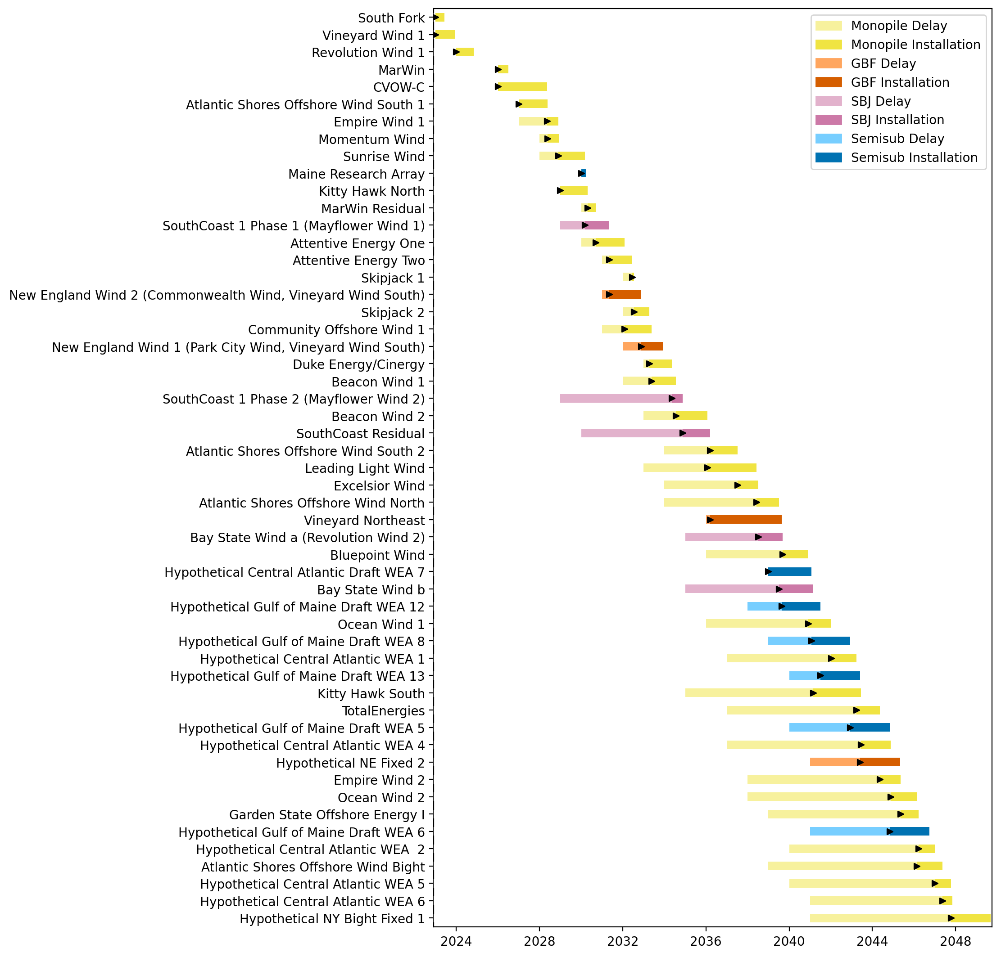
Full Gantt

Slide 2
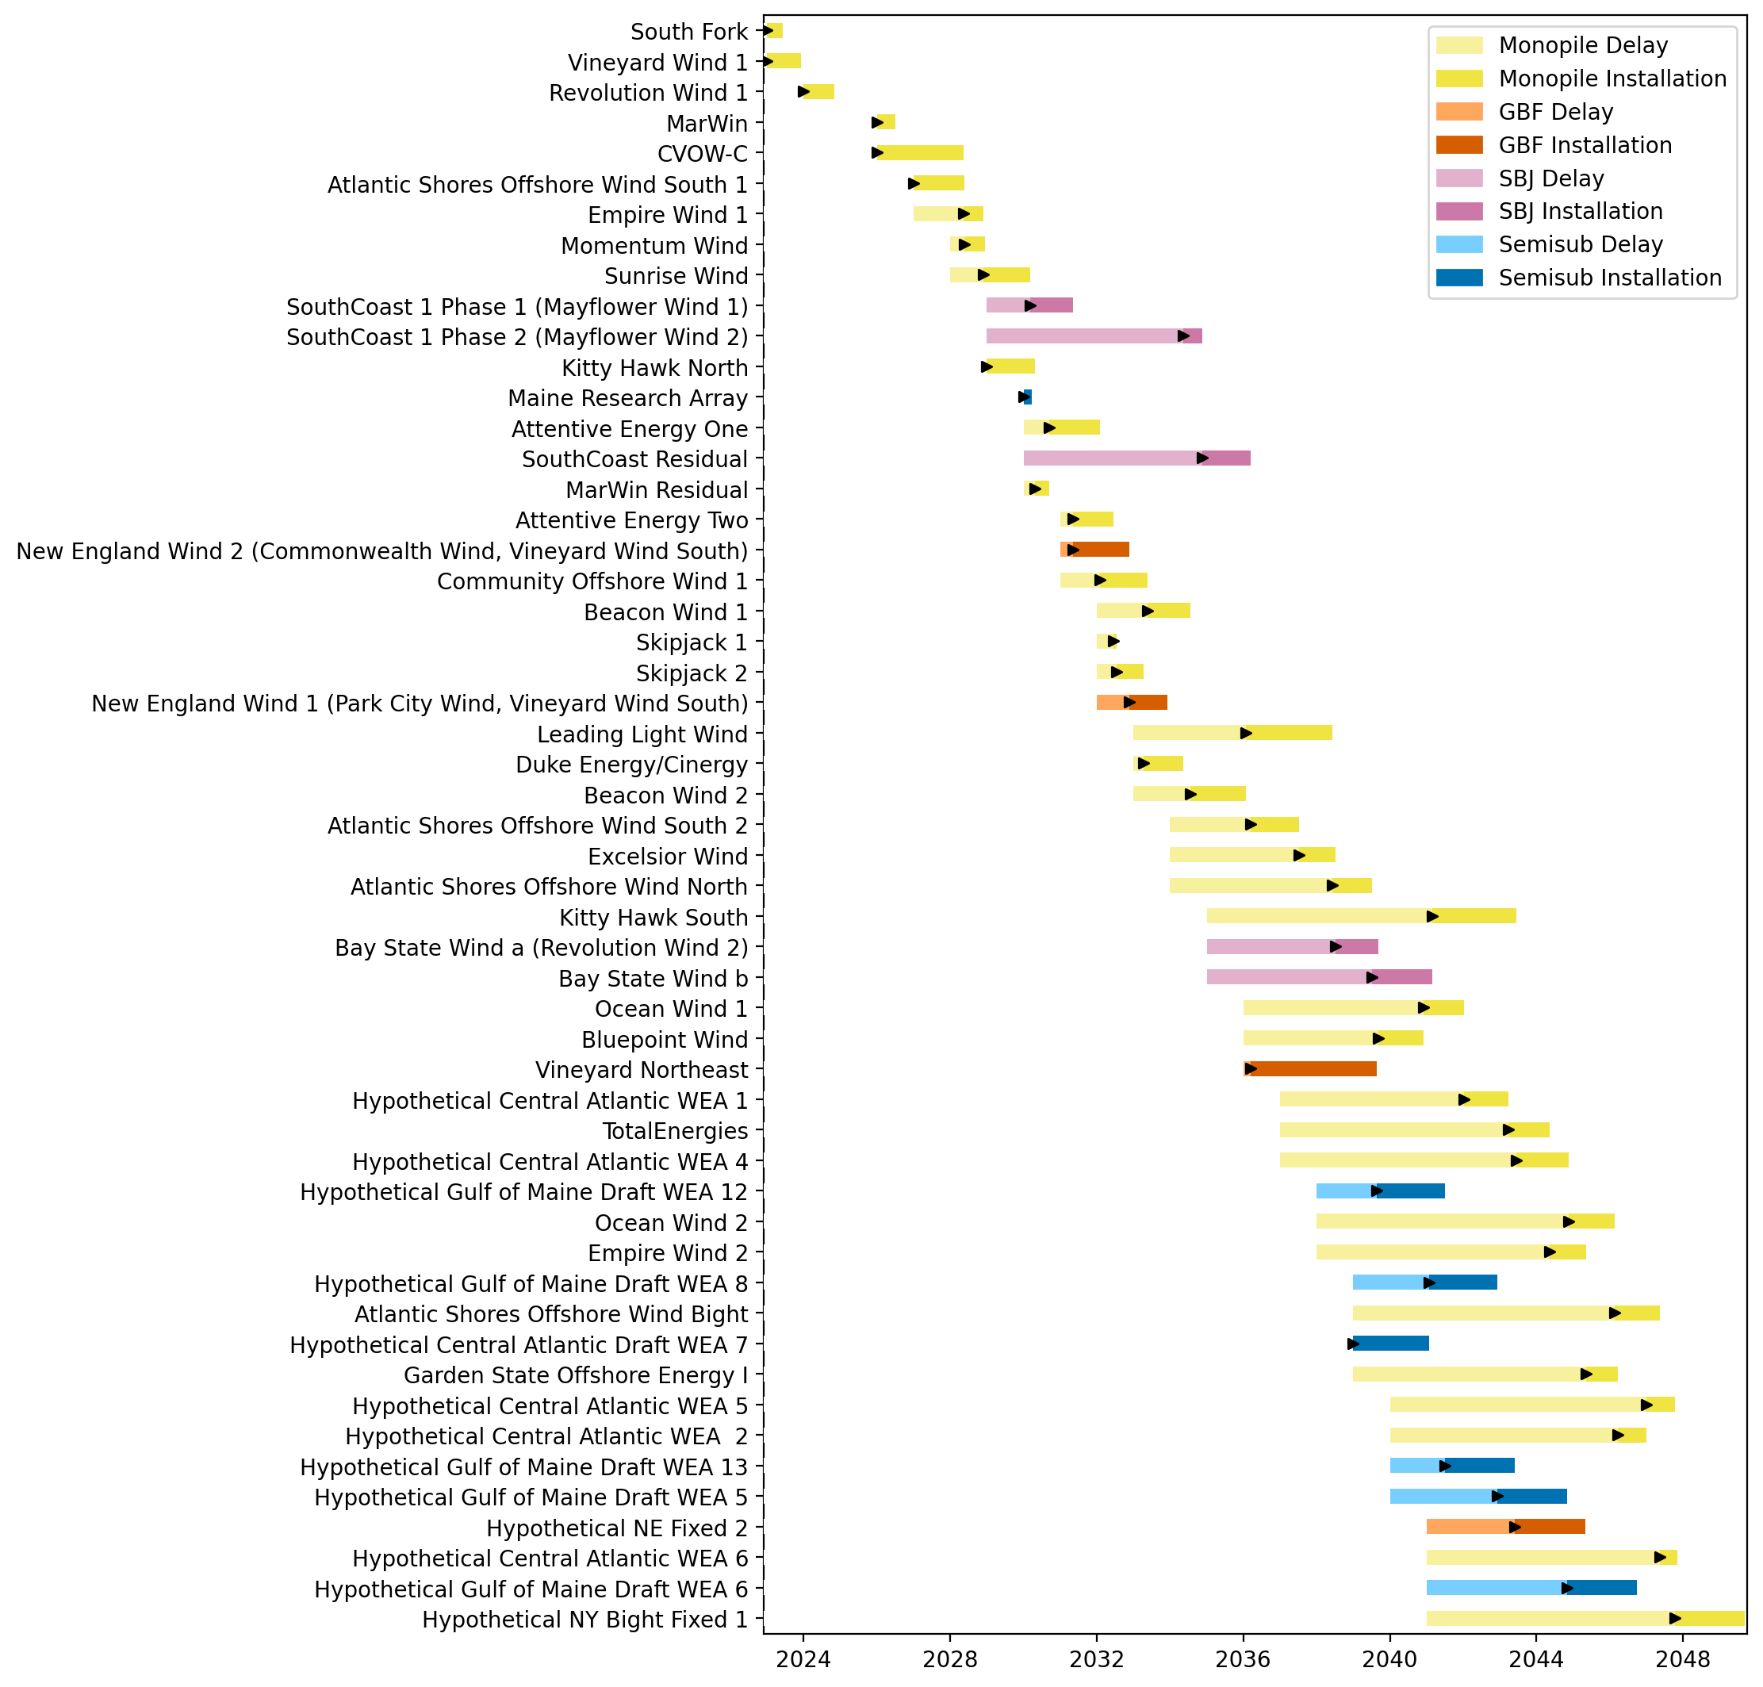
Sorted Full Gantt

Slide 3
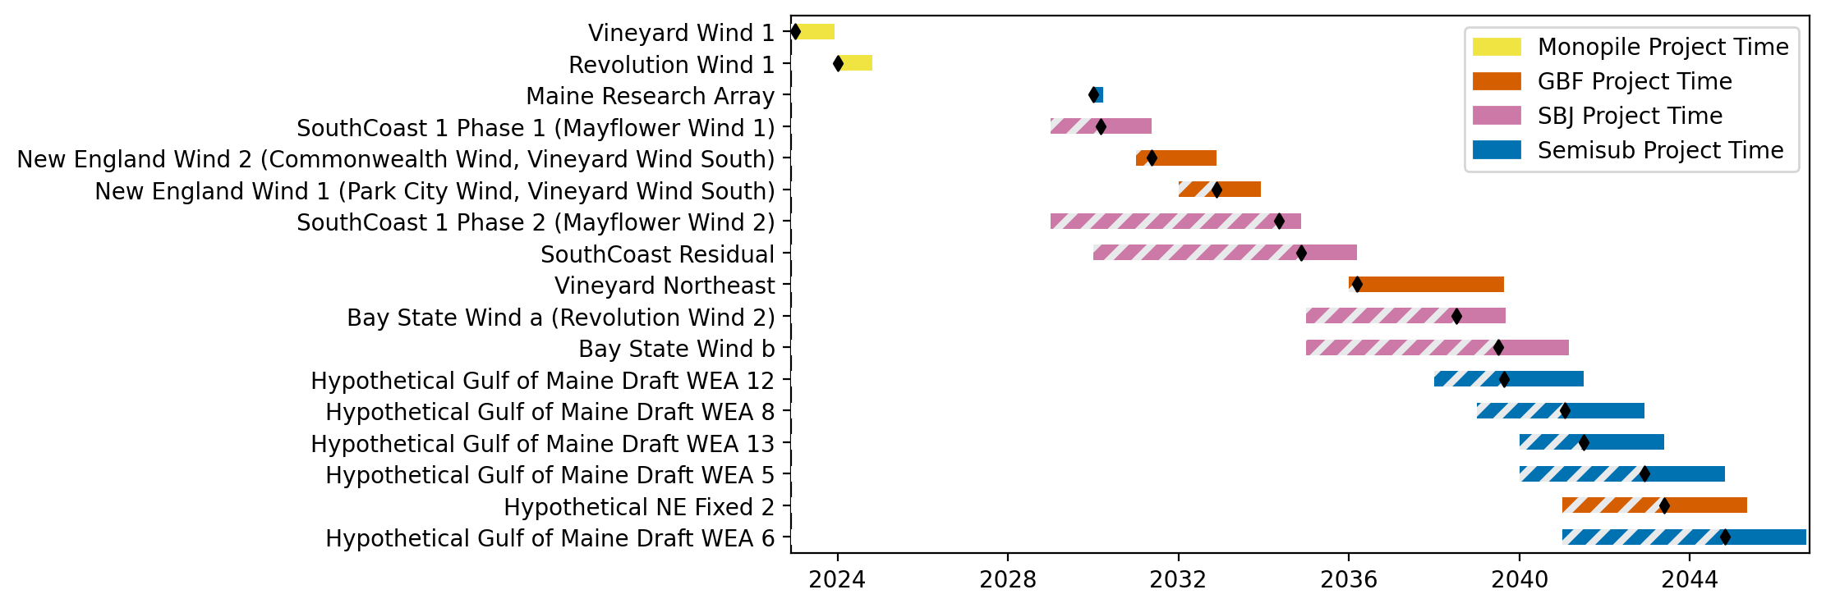
New England Gantt

Slide 4
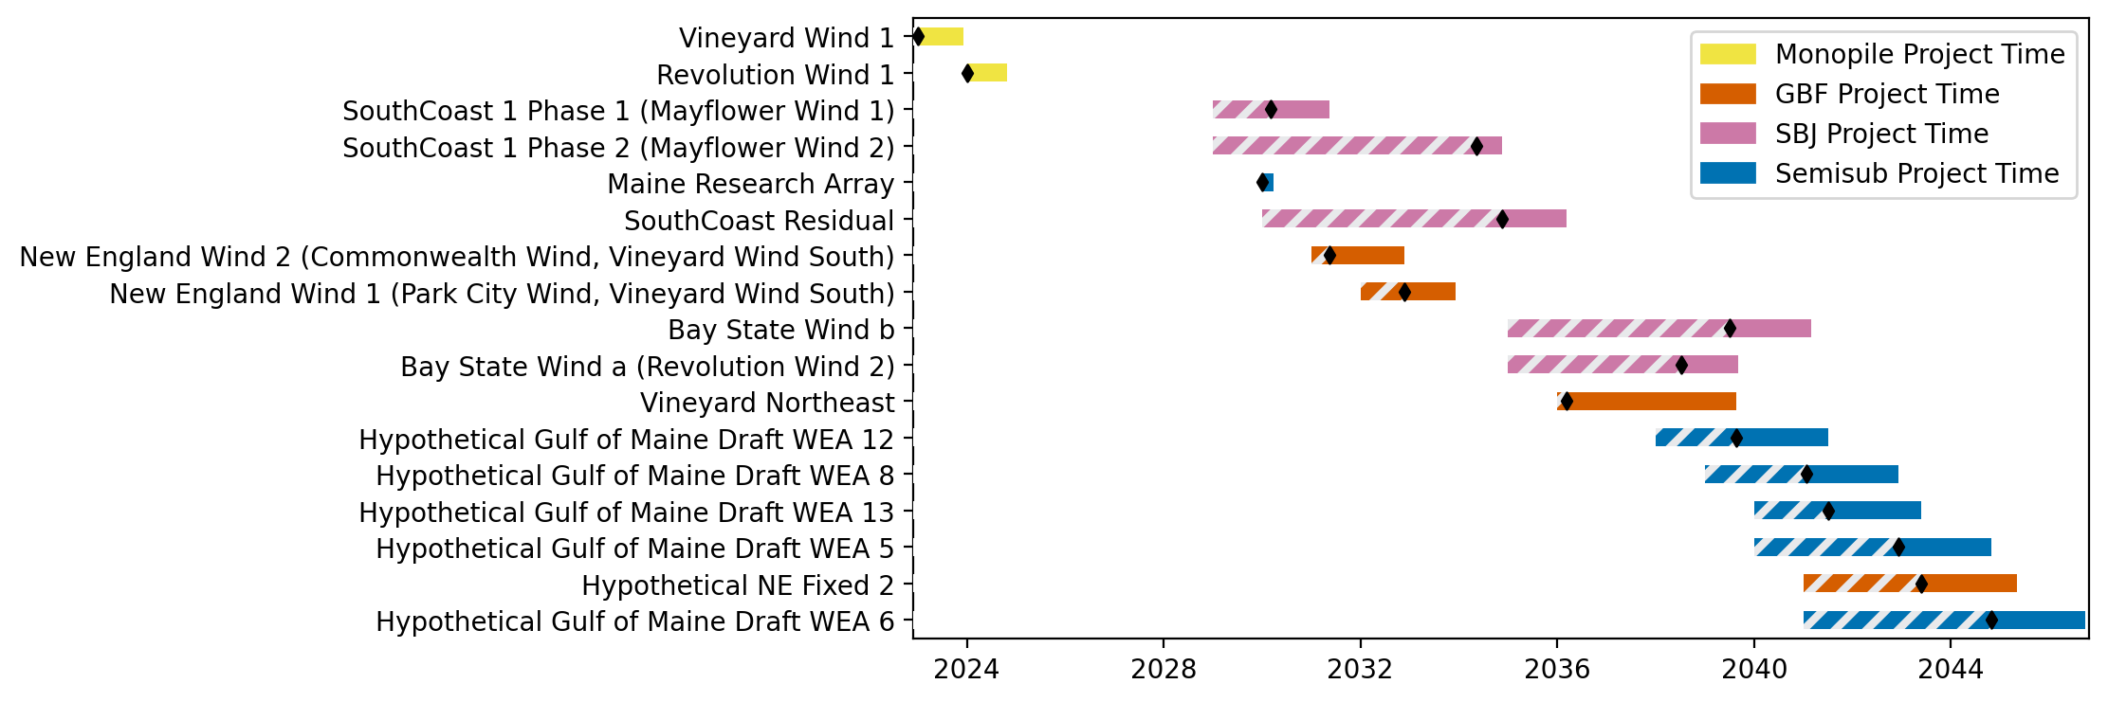
Sorted New England Gantt

Slide 5
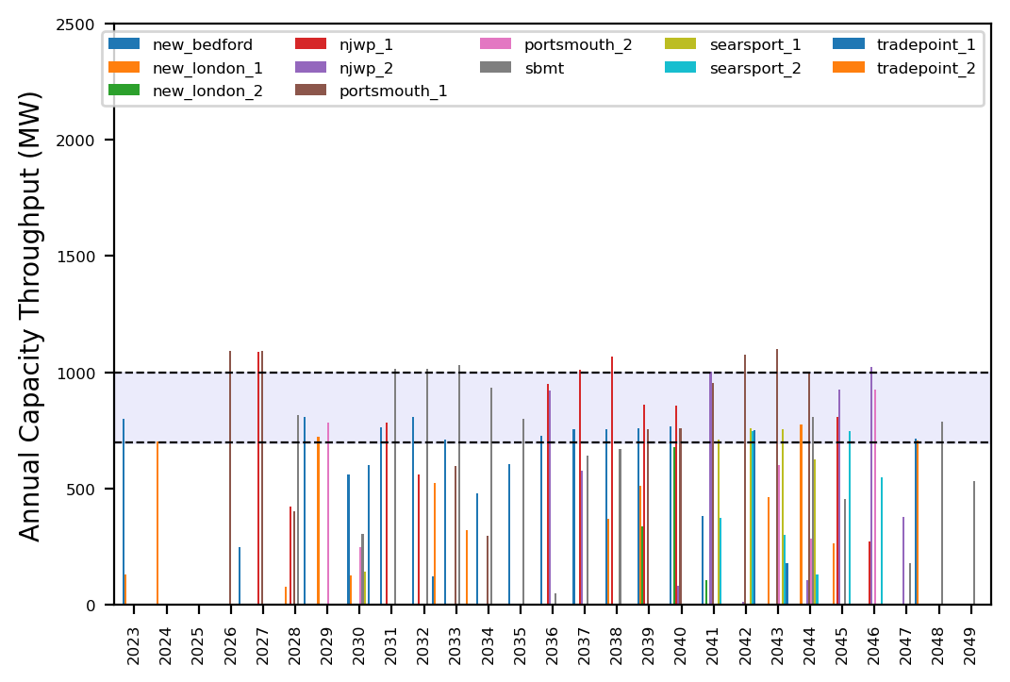
Port Throughput

Slide 6
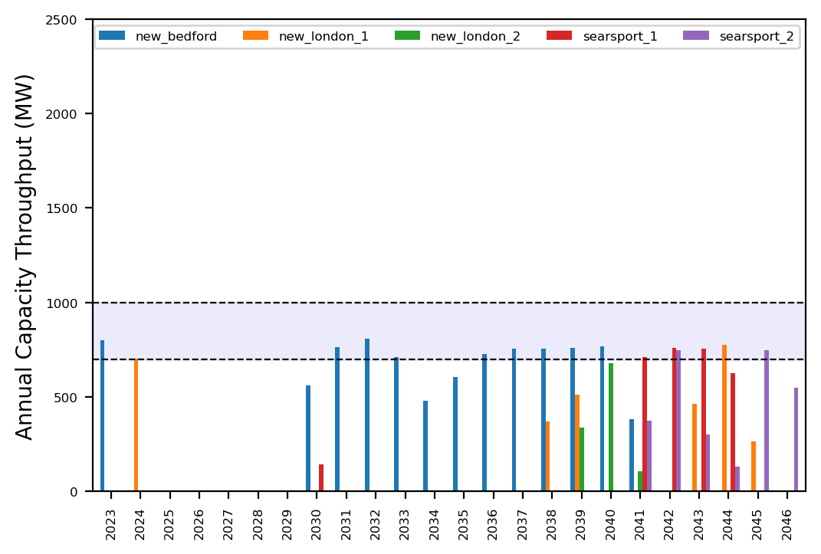
Port Throughput

Slide 7
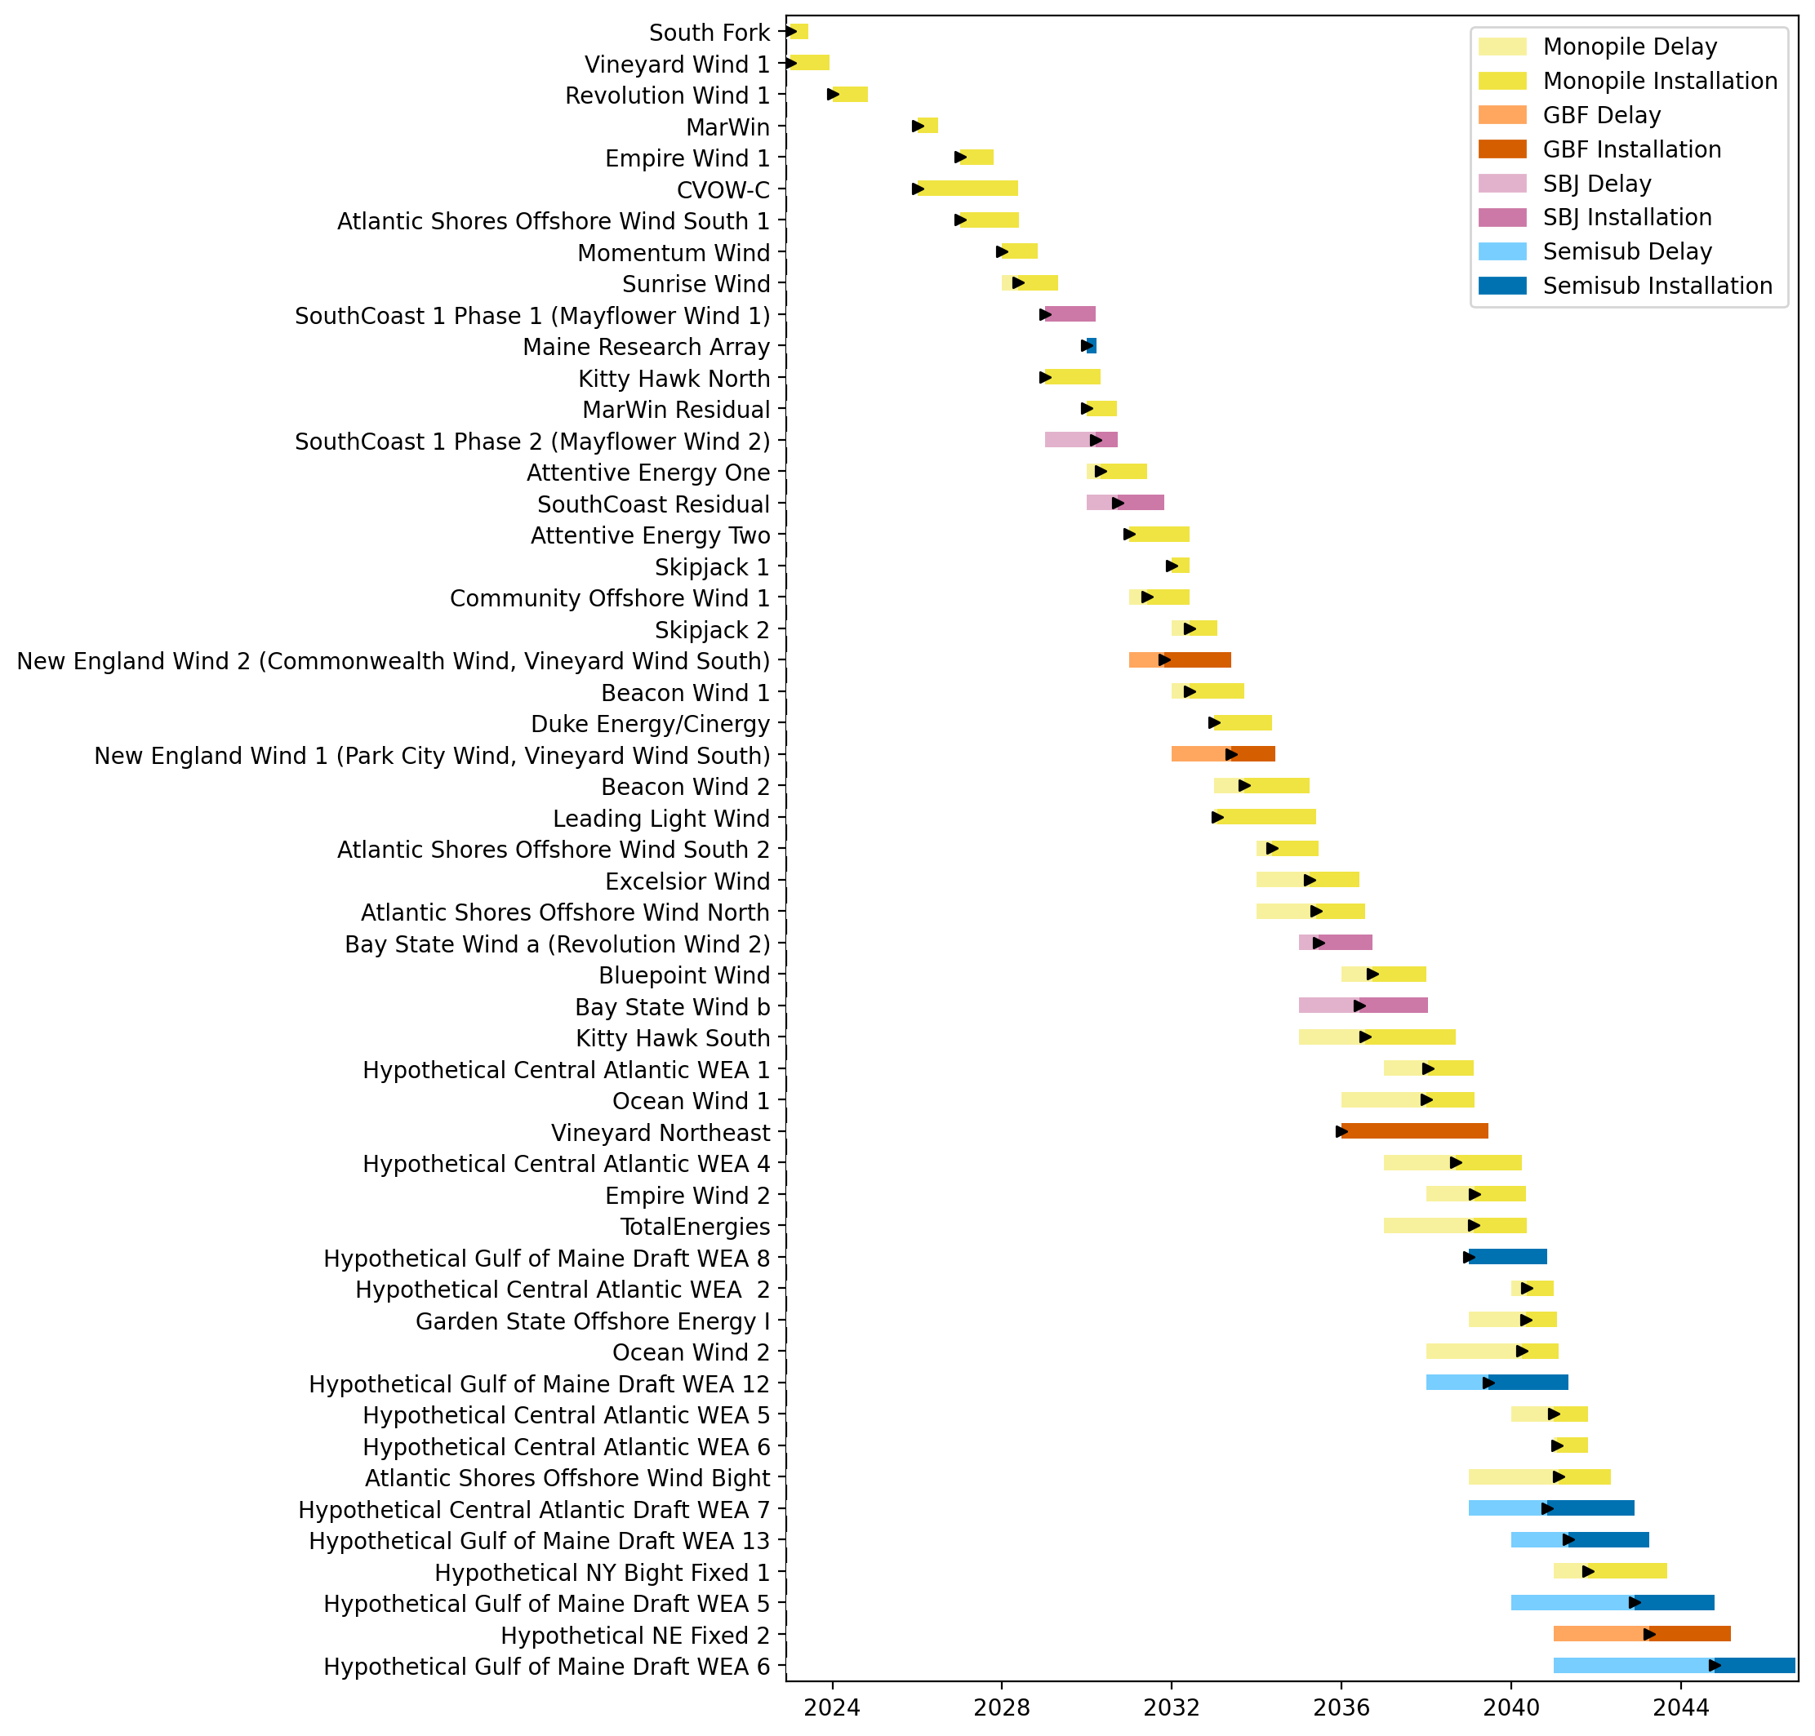
Full Gantt

Slide 8
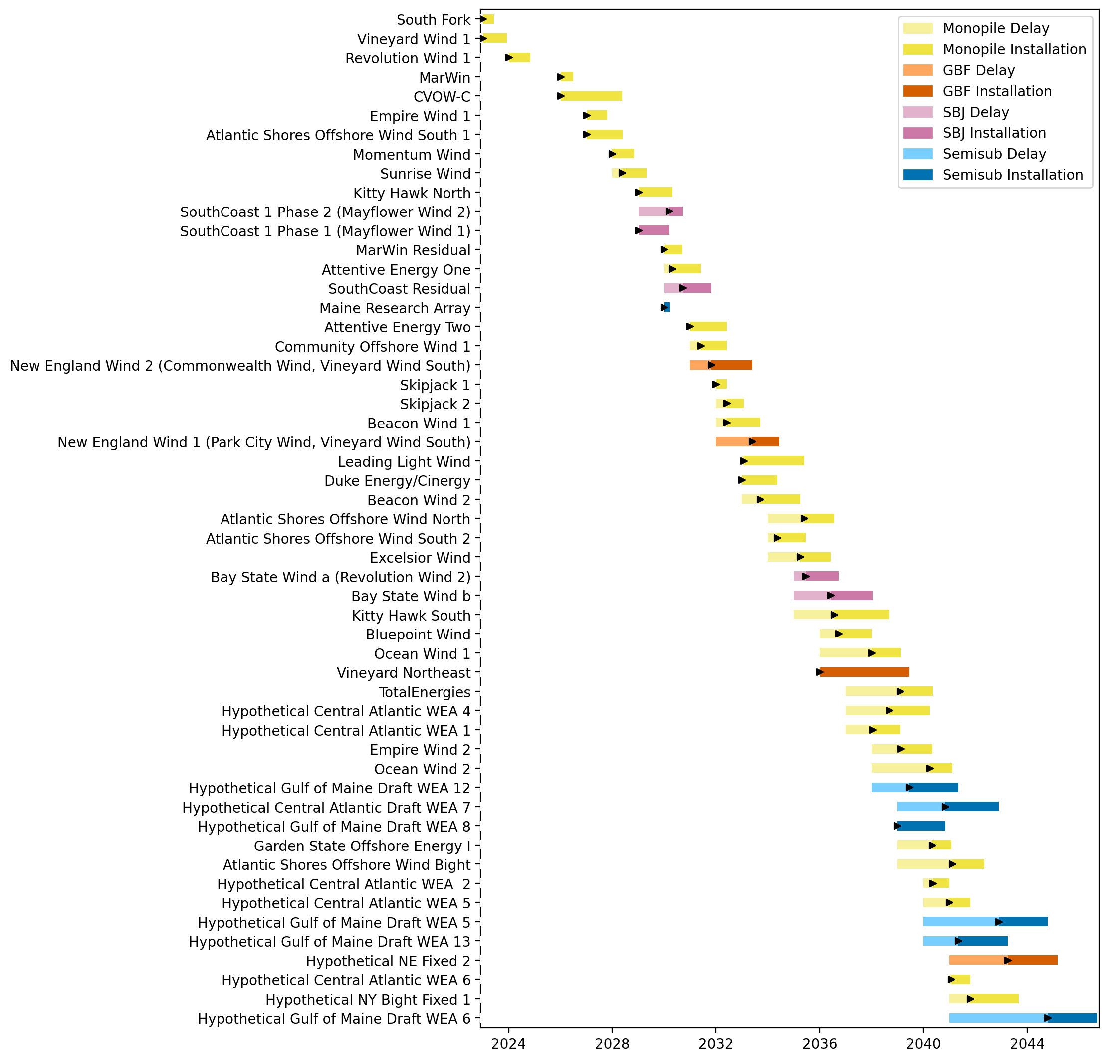
Sorted Full Gantt

Slide 9
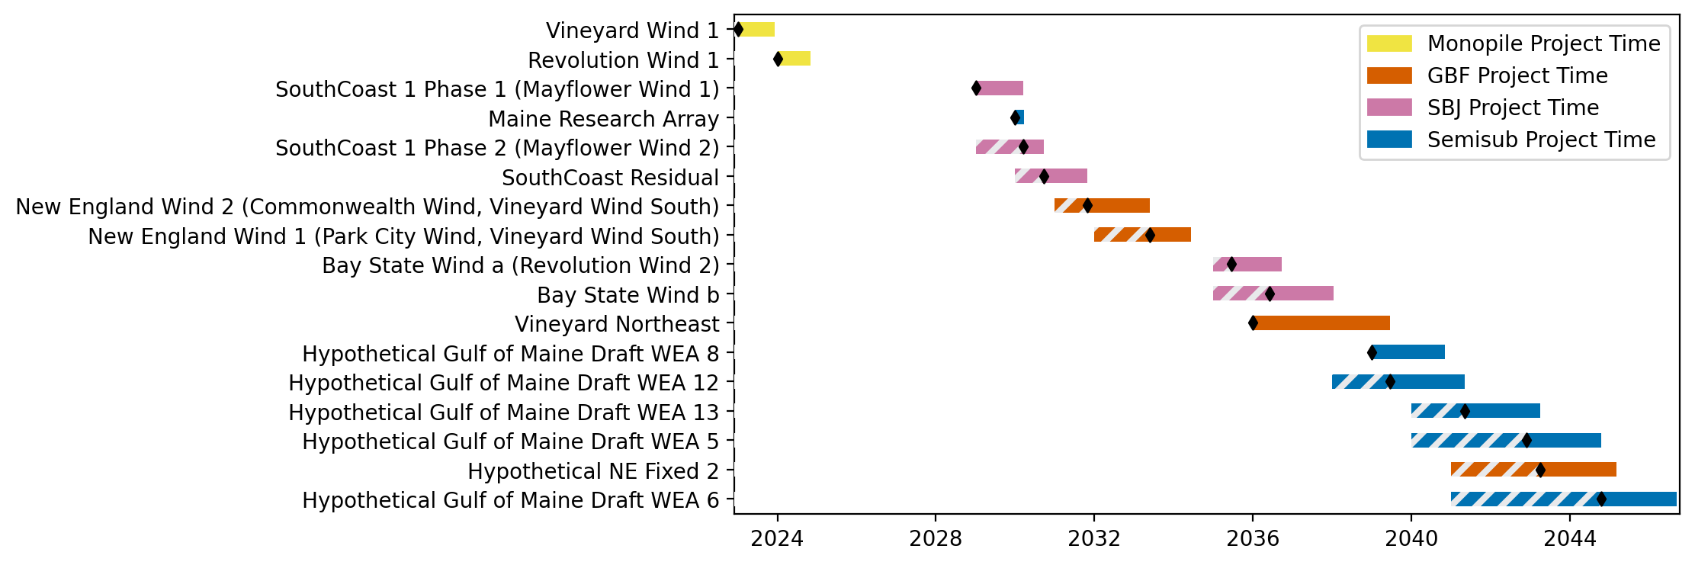
New England Gantt

Slide 10
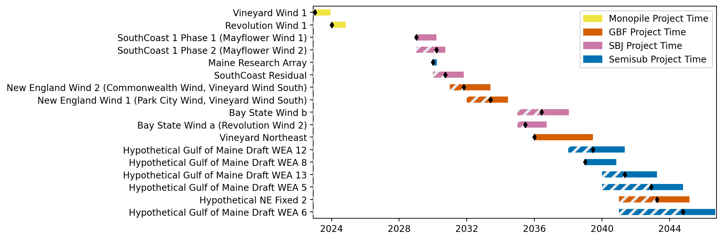
Sorted New England Gantt

Slide 11
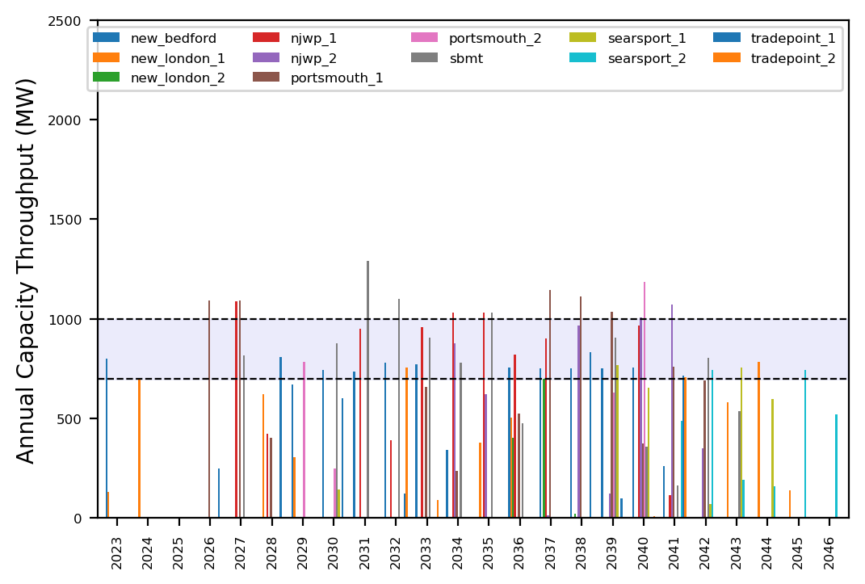
Port Throughput

Slide 12
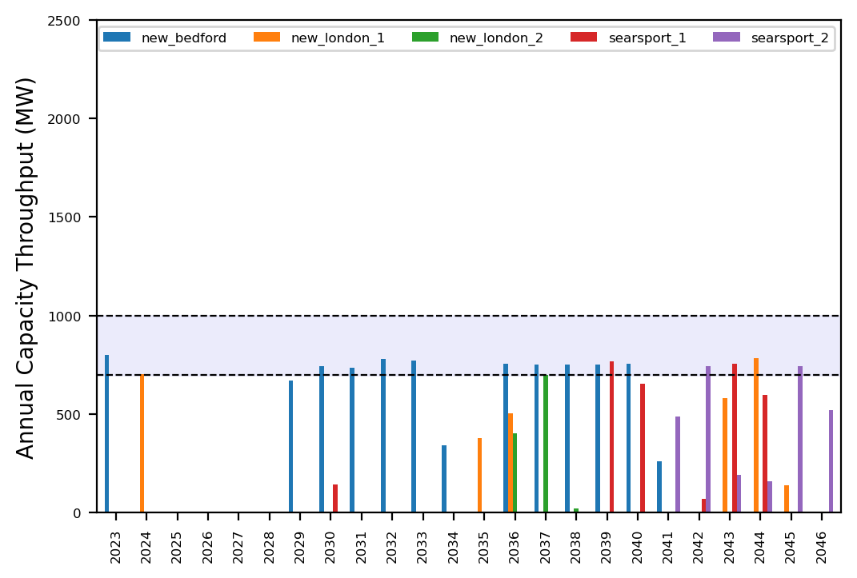
Port Throughput

Slide 13
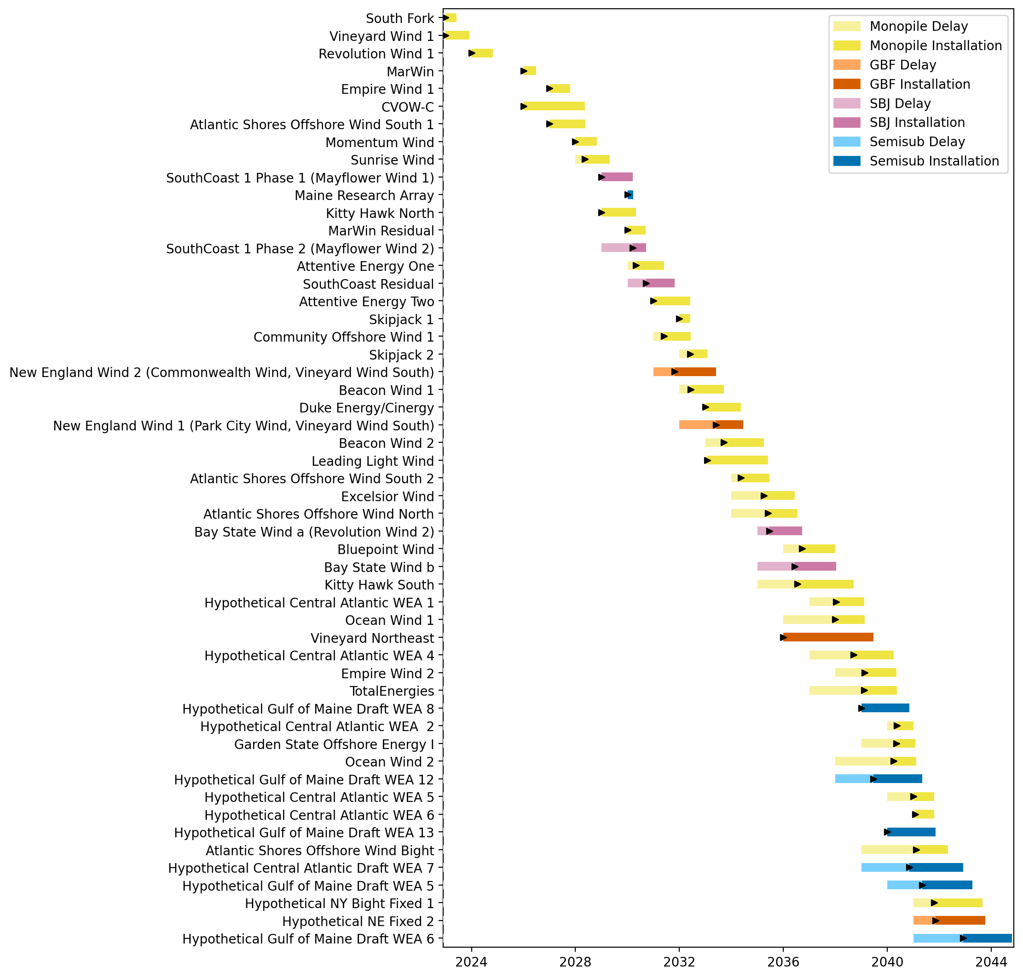
Full Gantt

Slide 14
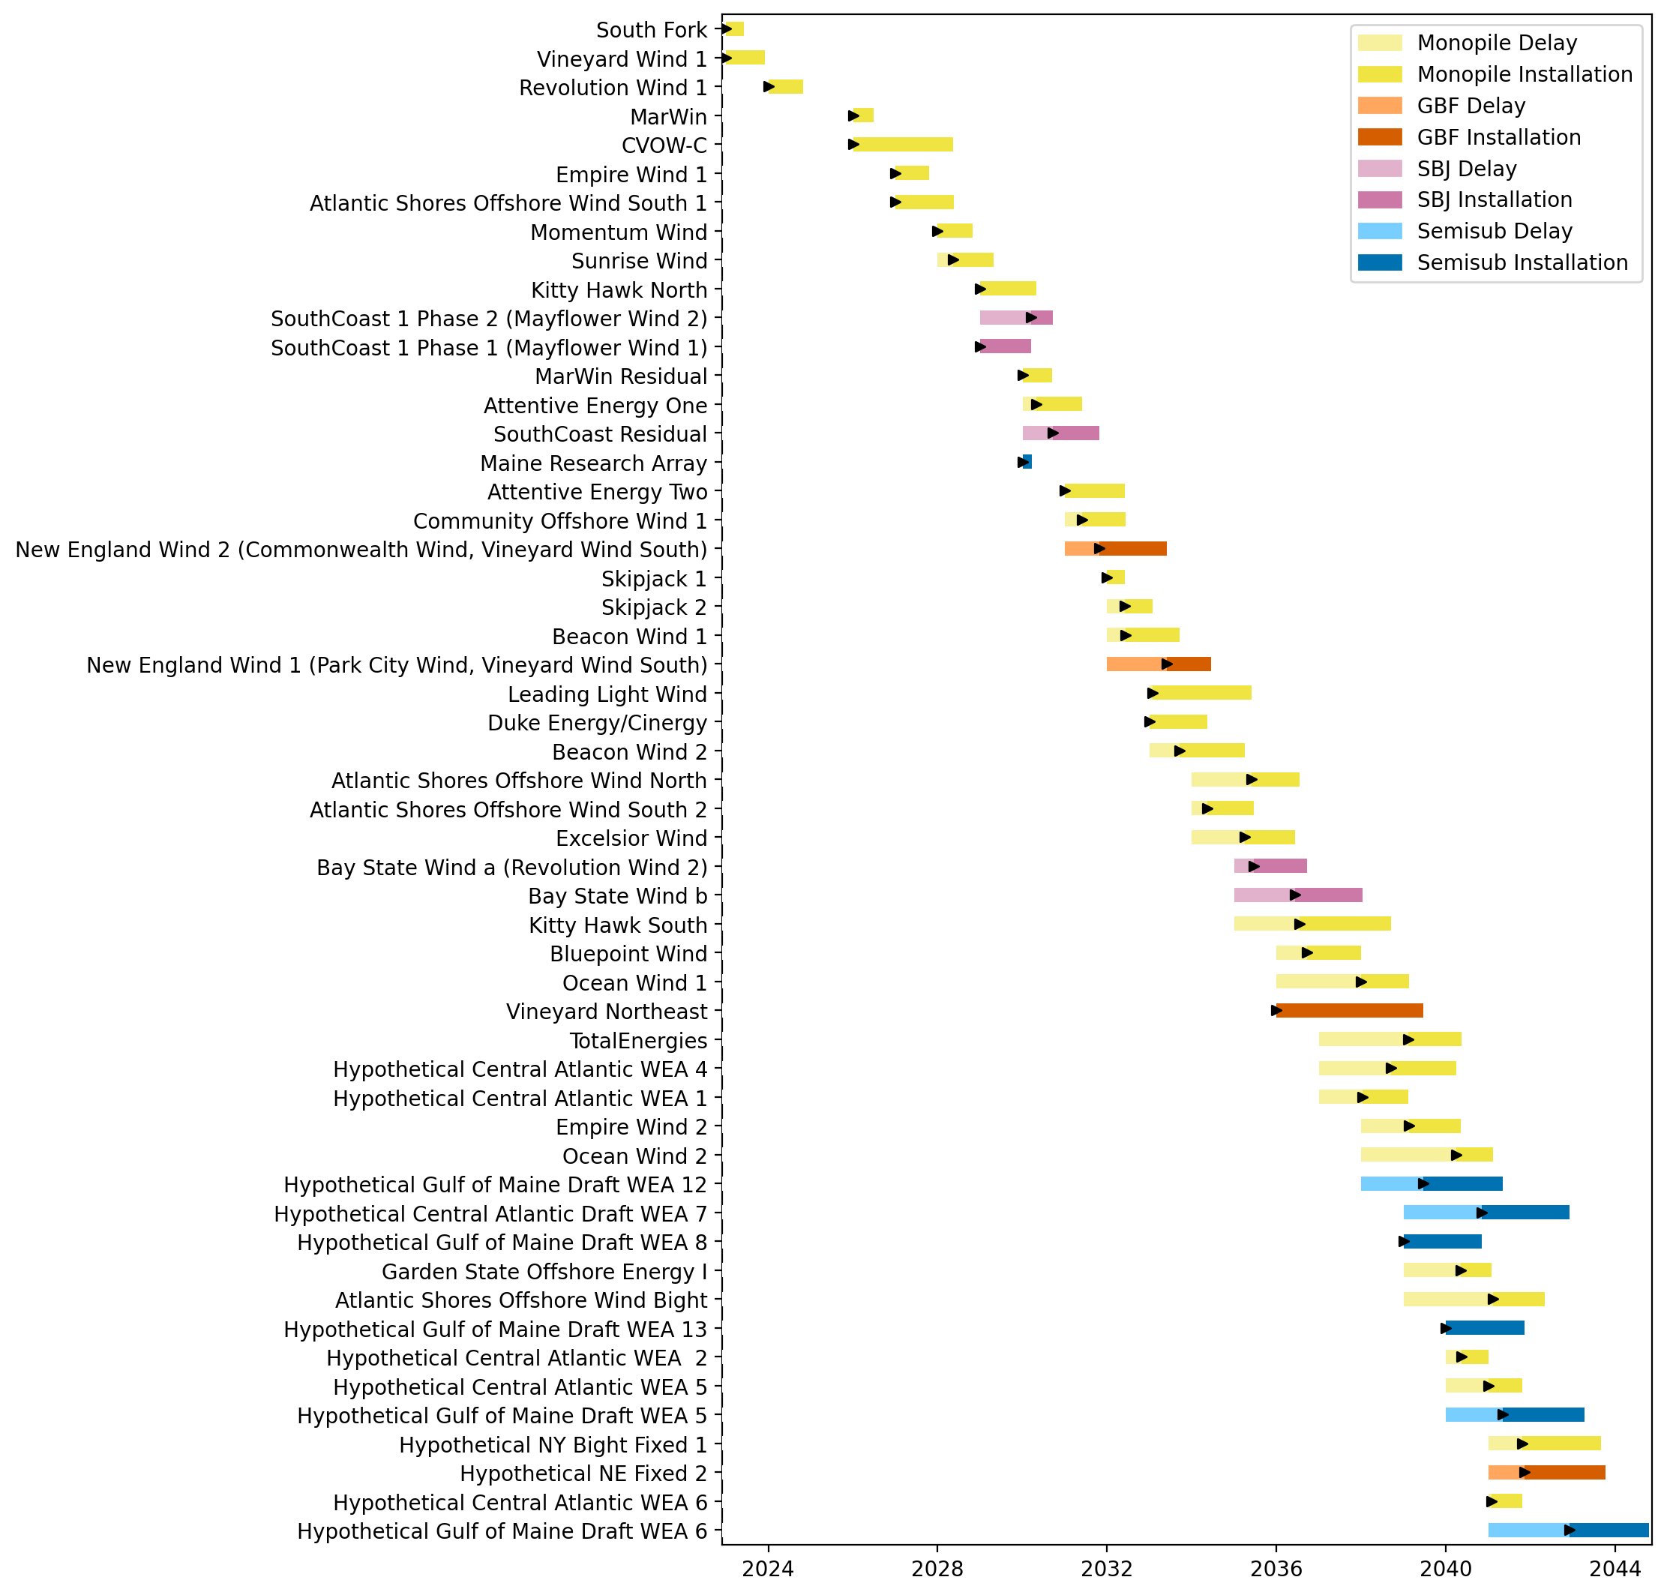
Sorted Full Gantt

Slide 15
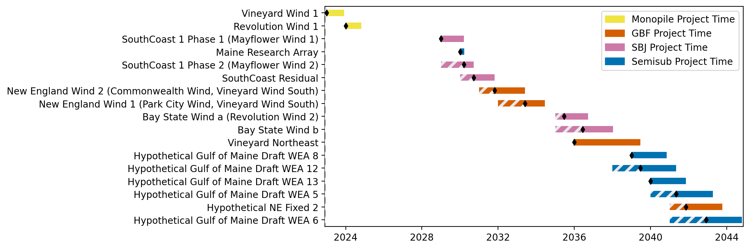
New England Gantt

Slide 16
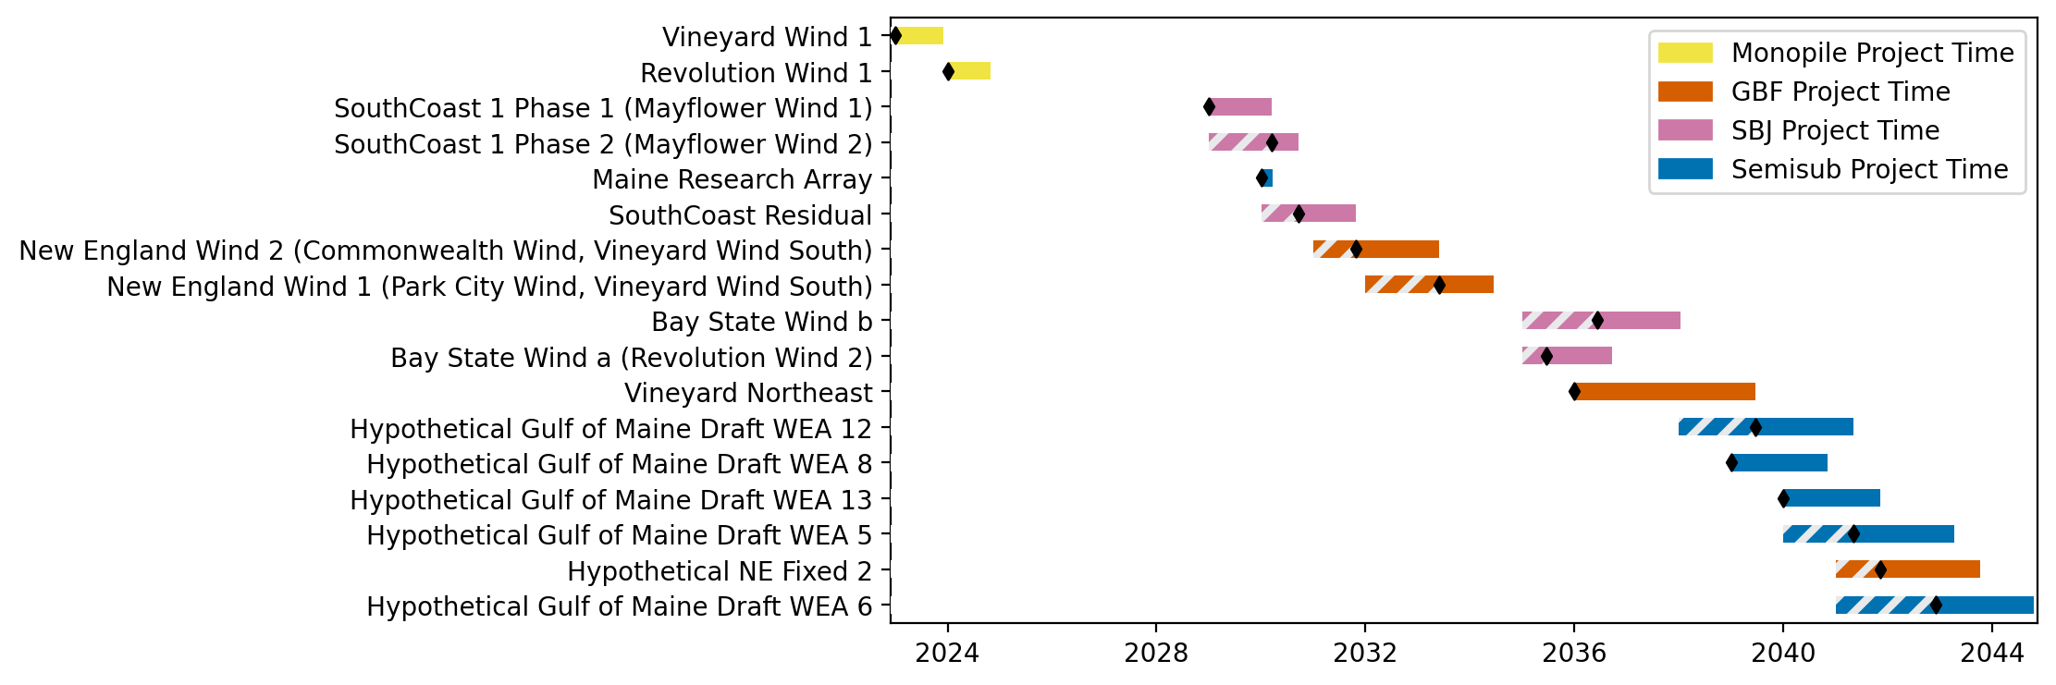
Sorted New England Gantt

Slide 17
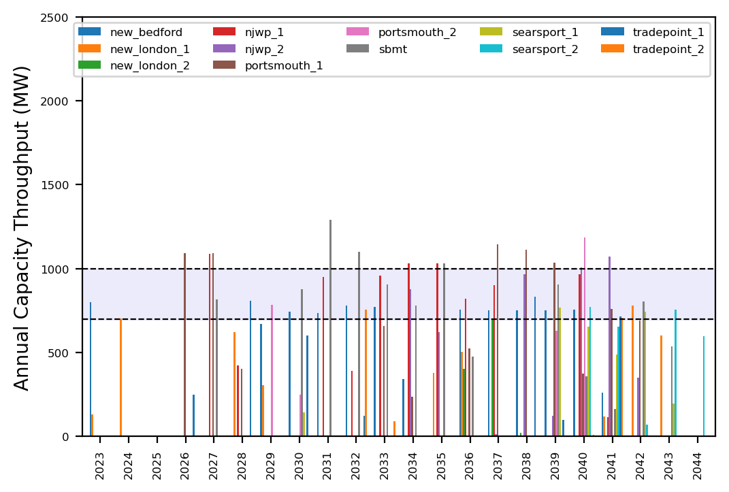
Port Throughput

Slide 18
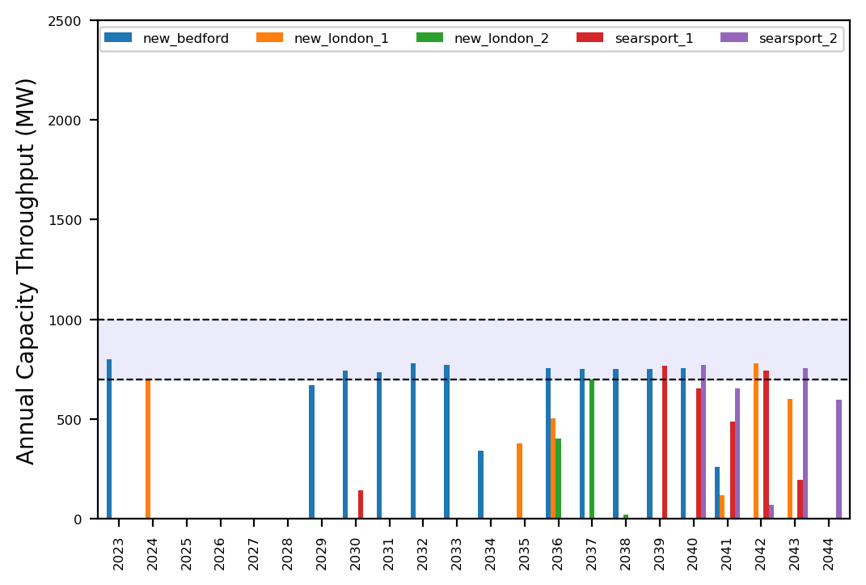
Port Throughput

Slide 19
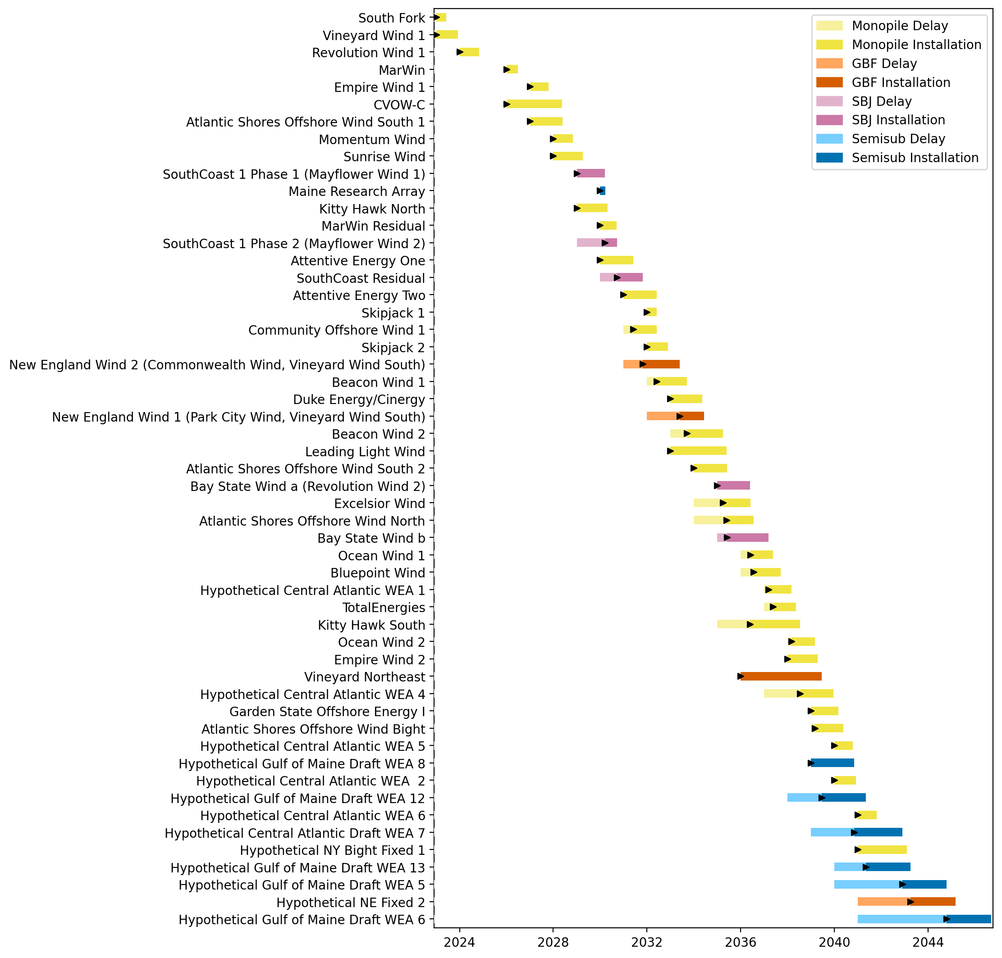
Full Gantt

Slide 20
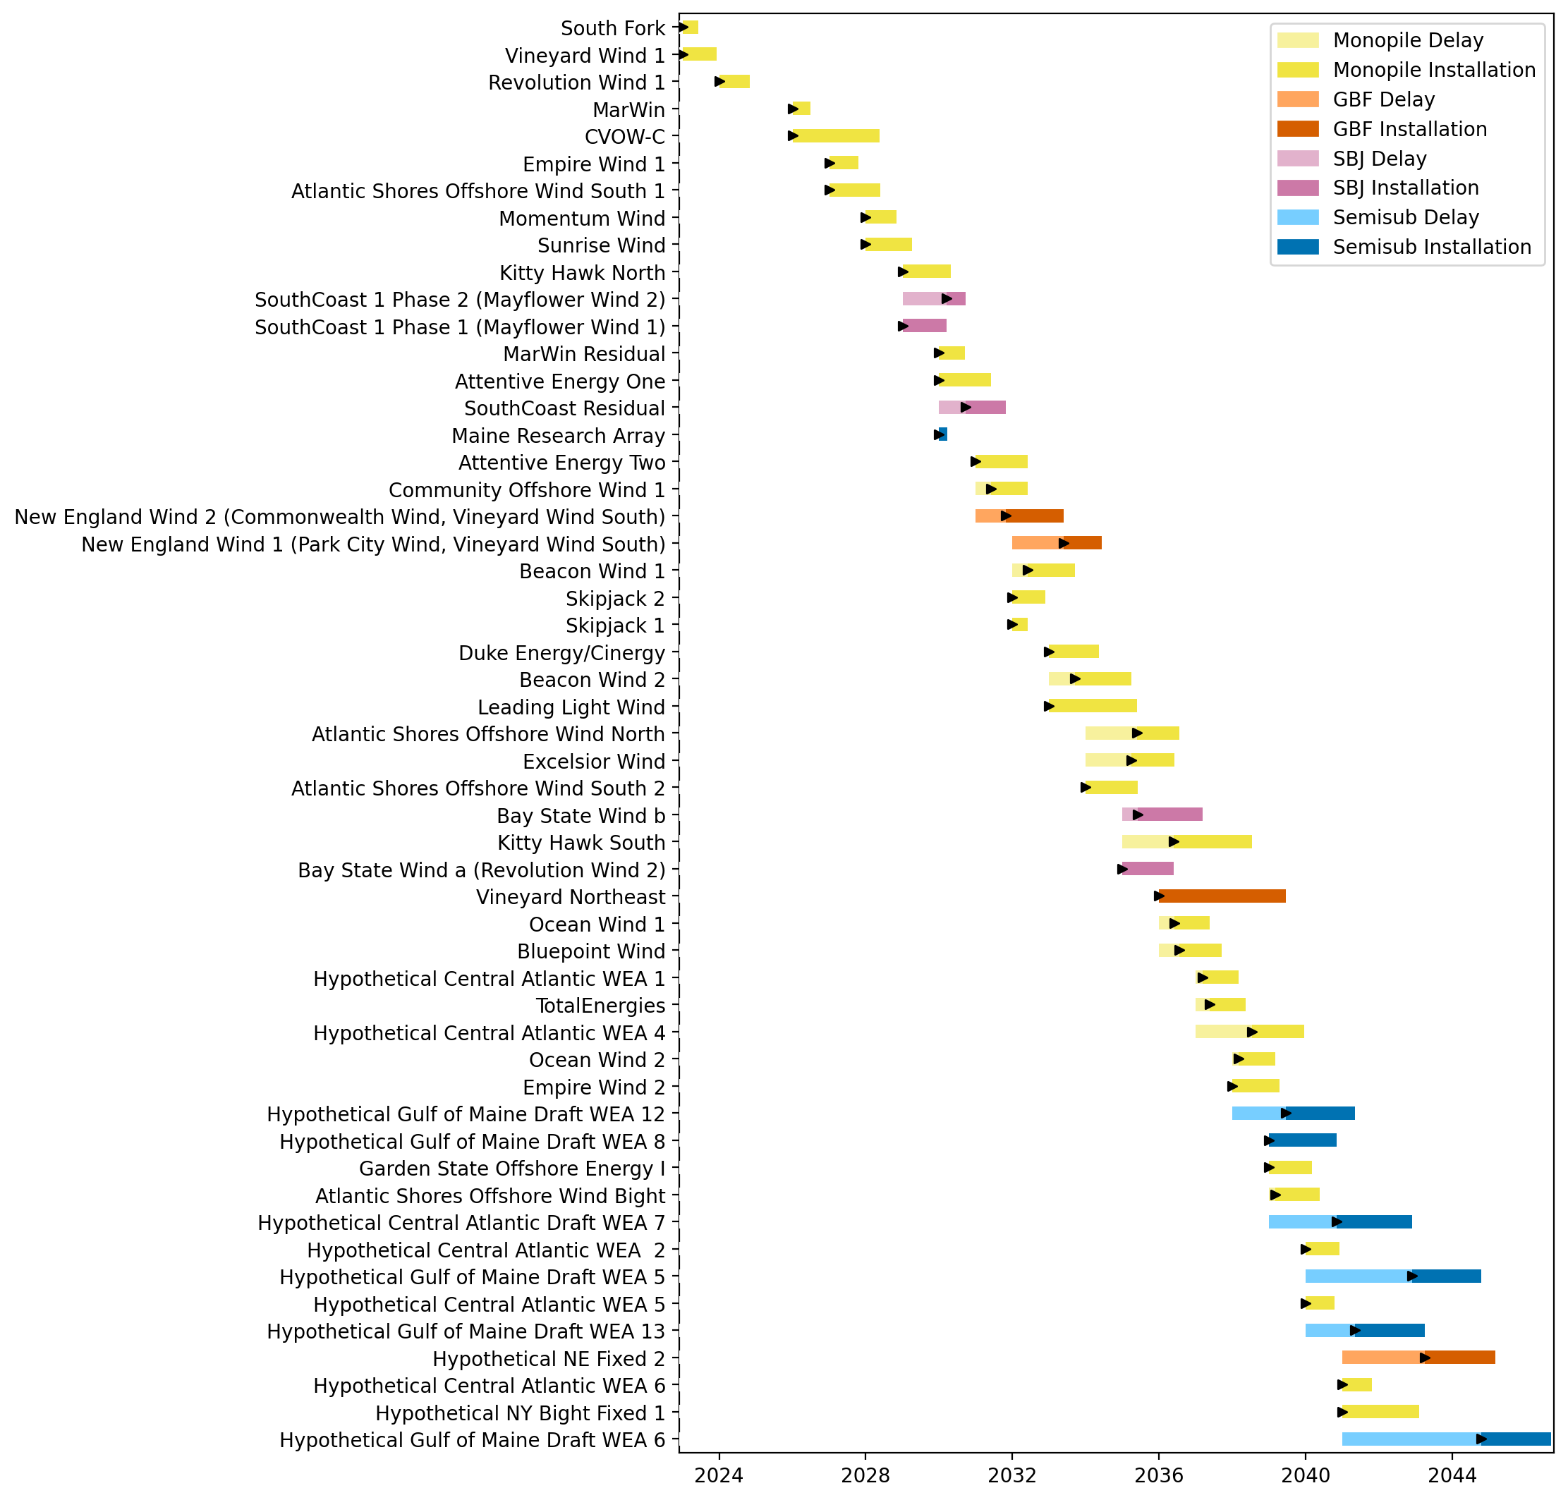
Sorted Full Gantt

Slide 21

New England Gantt

Slide 22

Sorted New England Gantt

Slide 23
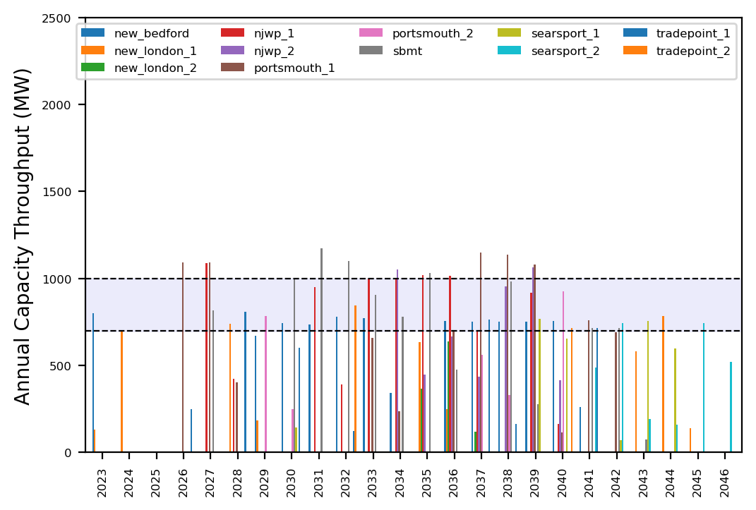
Port Throughput

Slide 24

Port Throughput

Slide 25
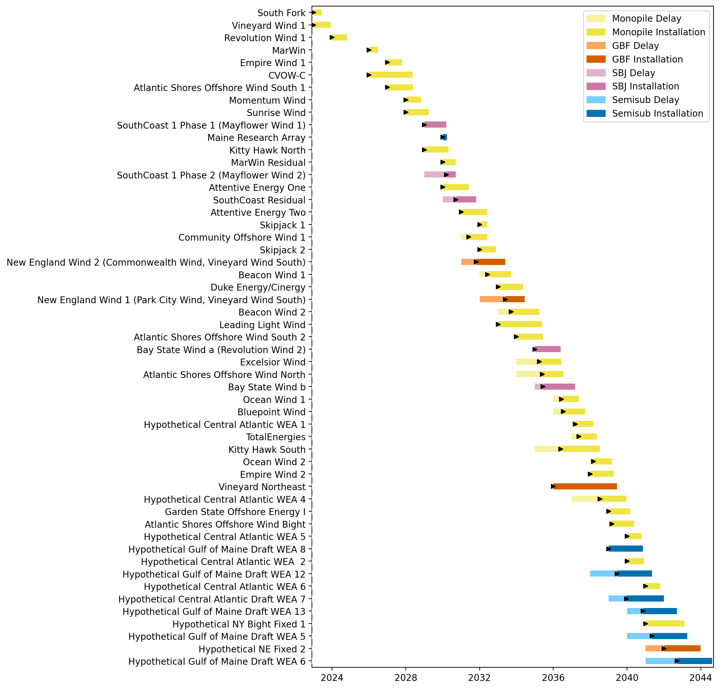
Full Gantt

Slide 26
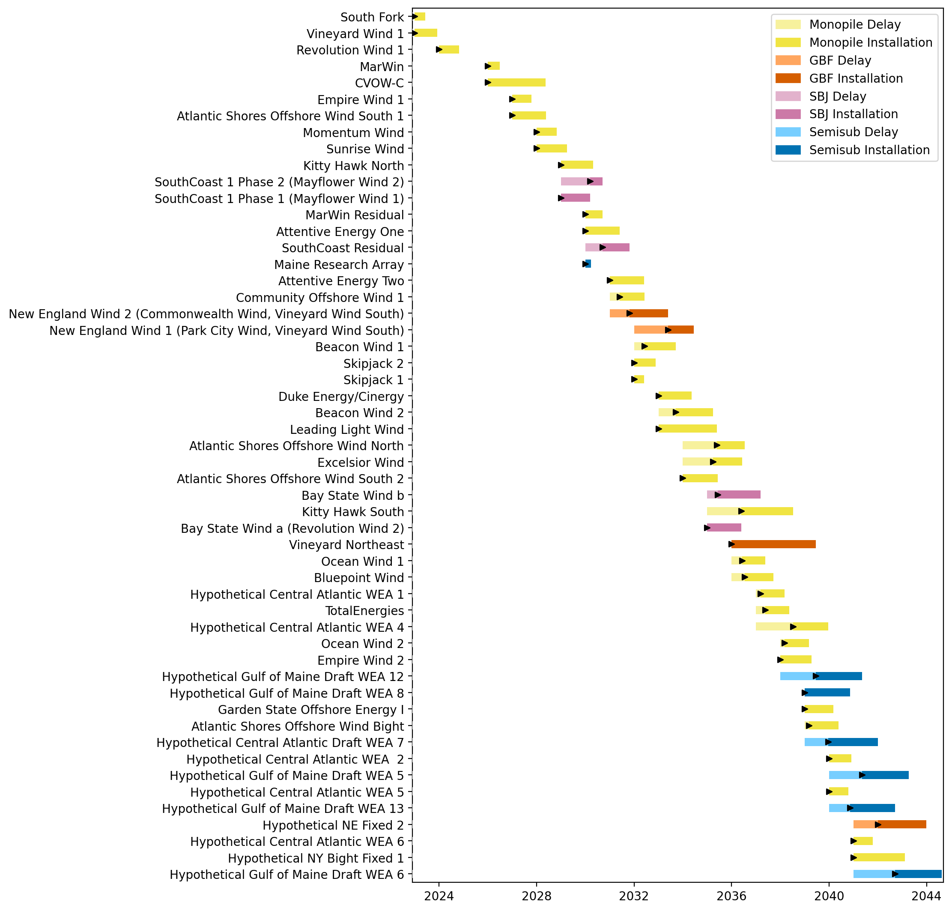
Sorted Full Gantt

Slide 27
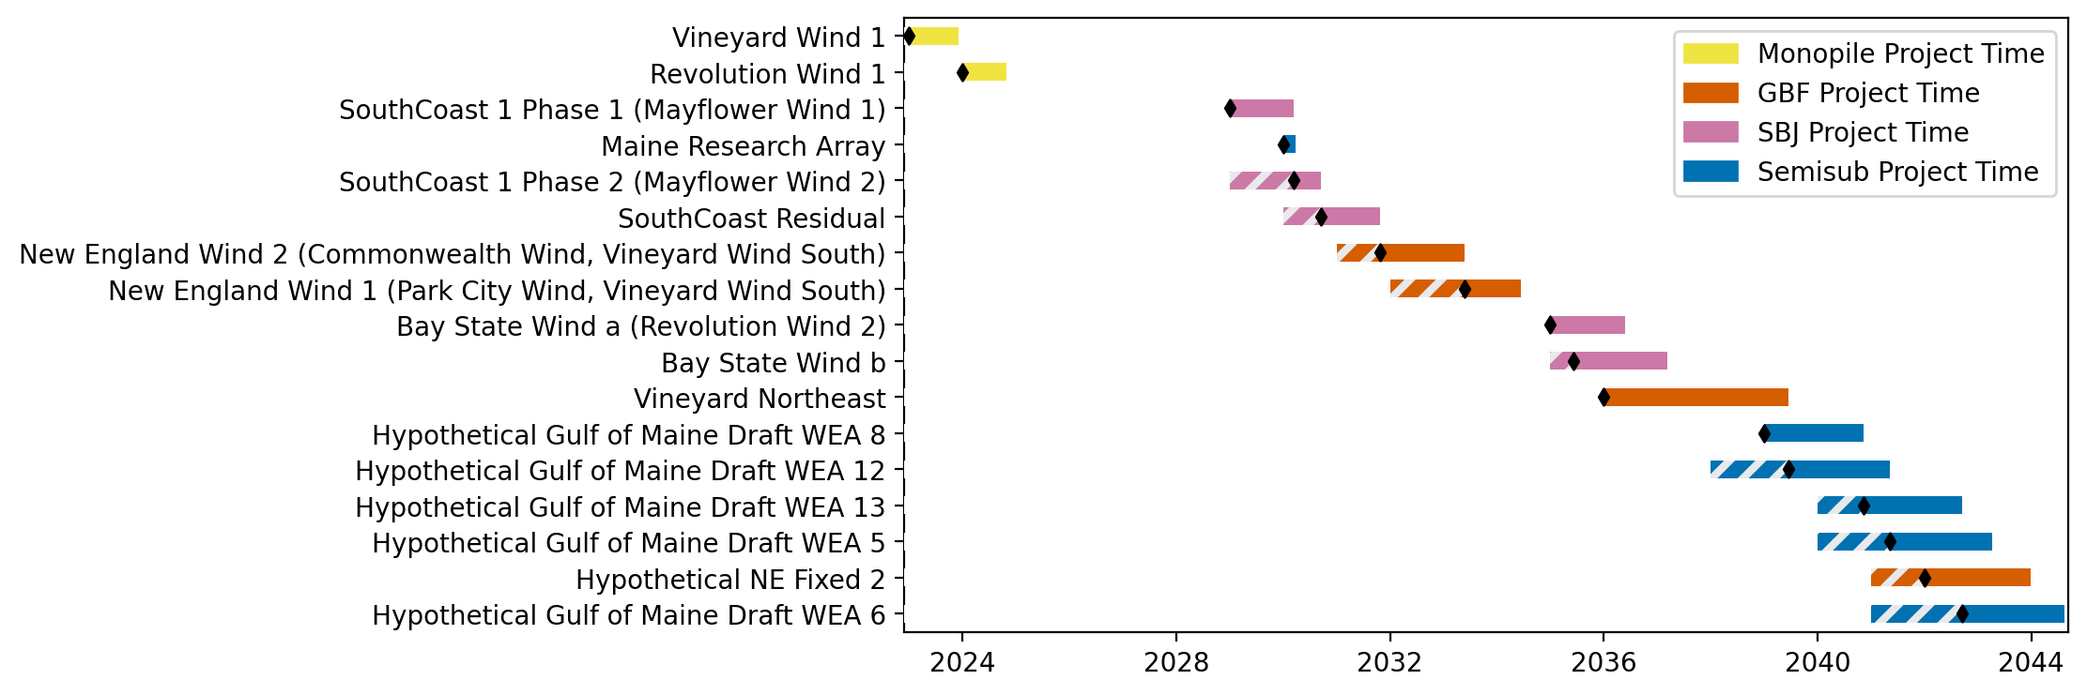
New England Gantt

Slide 28
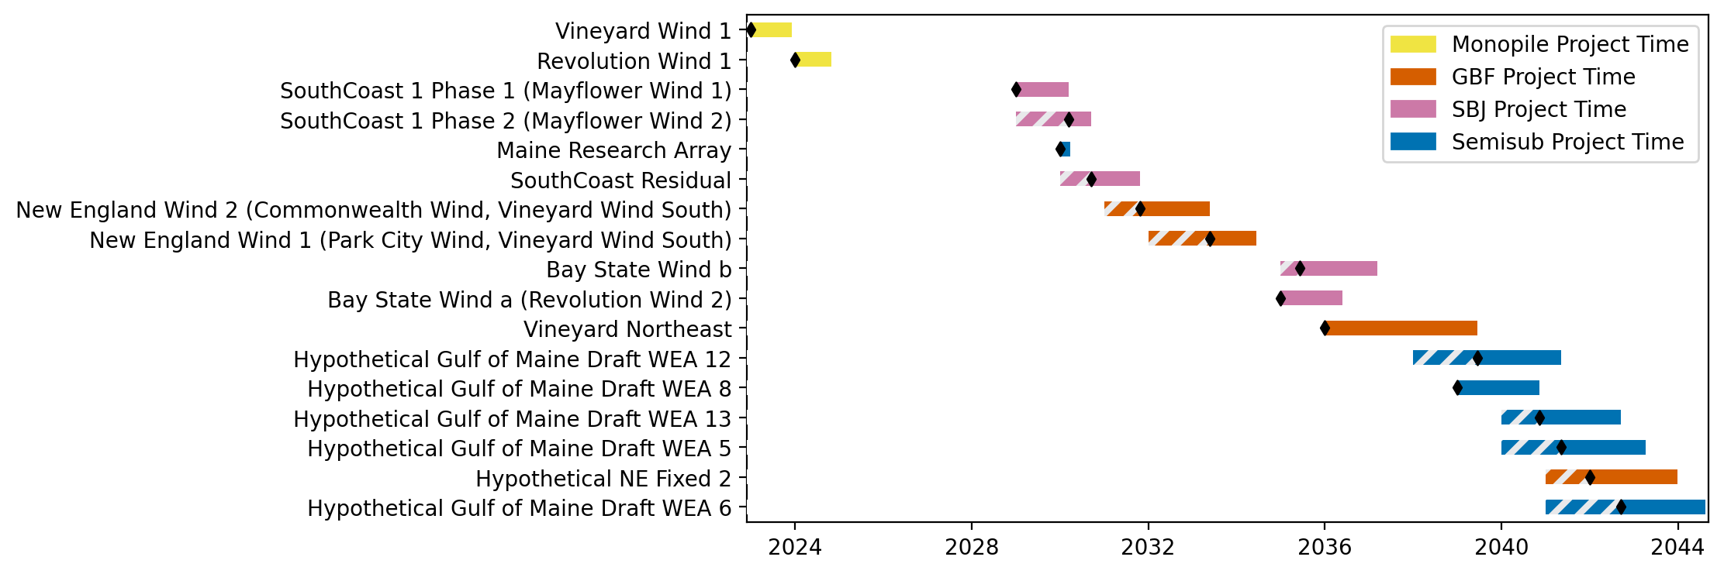
Sorted New England Gantt

Slide 29
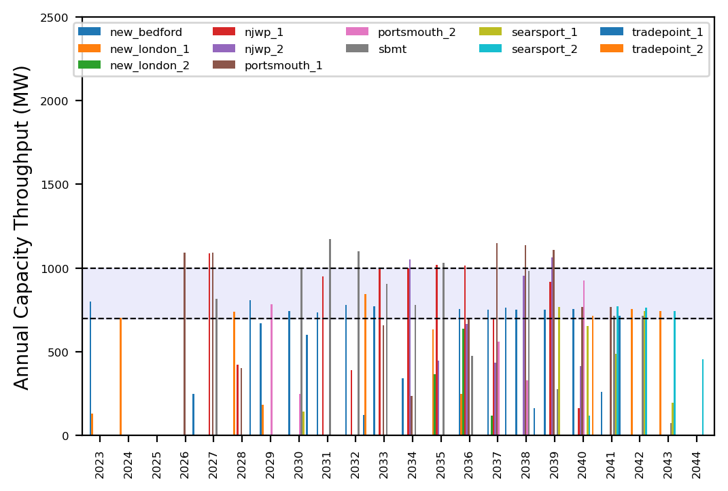
Port Throughput

Slide 30

Port Throughput

Slide 31
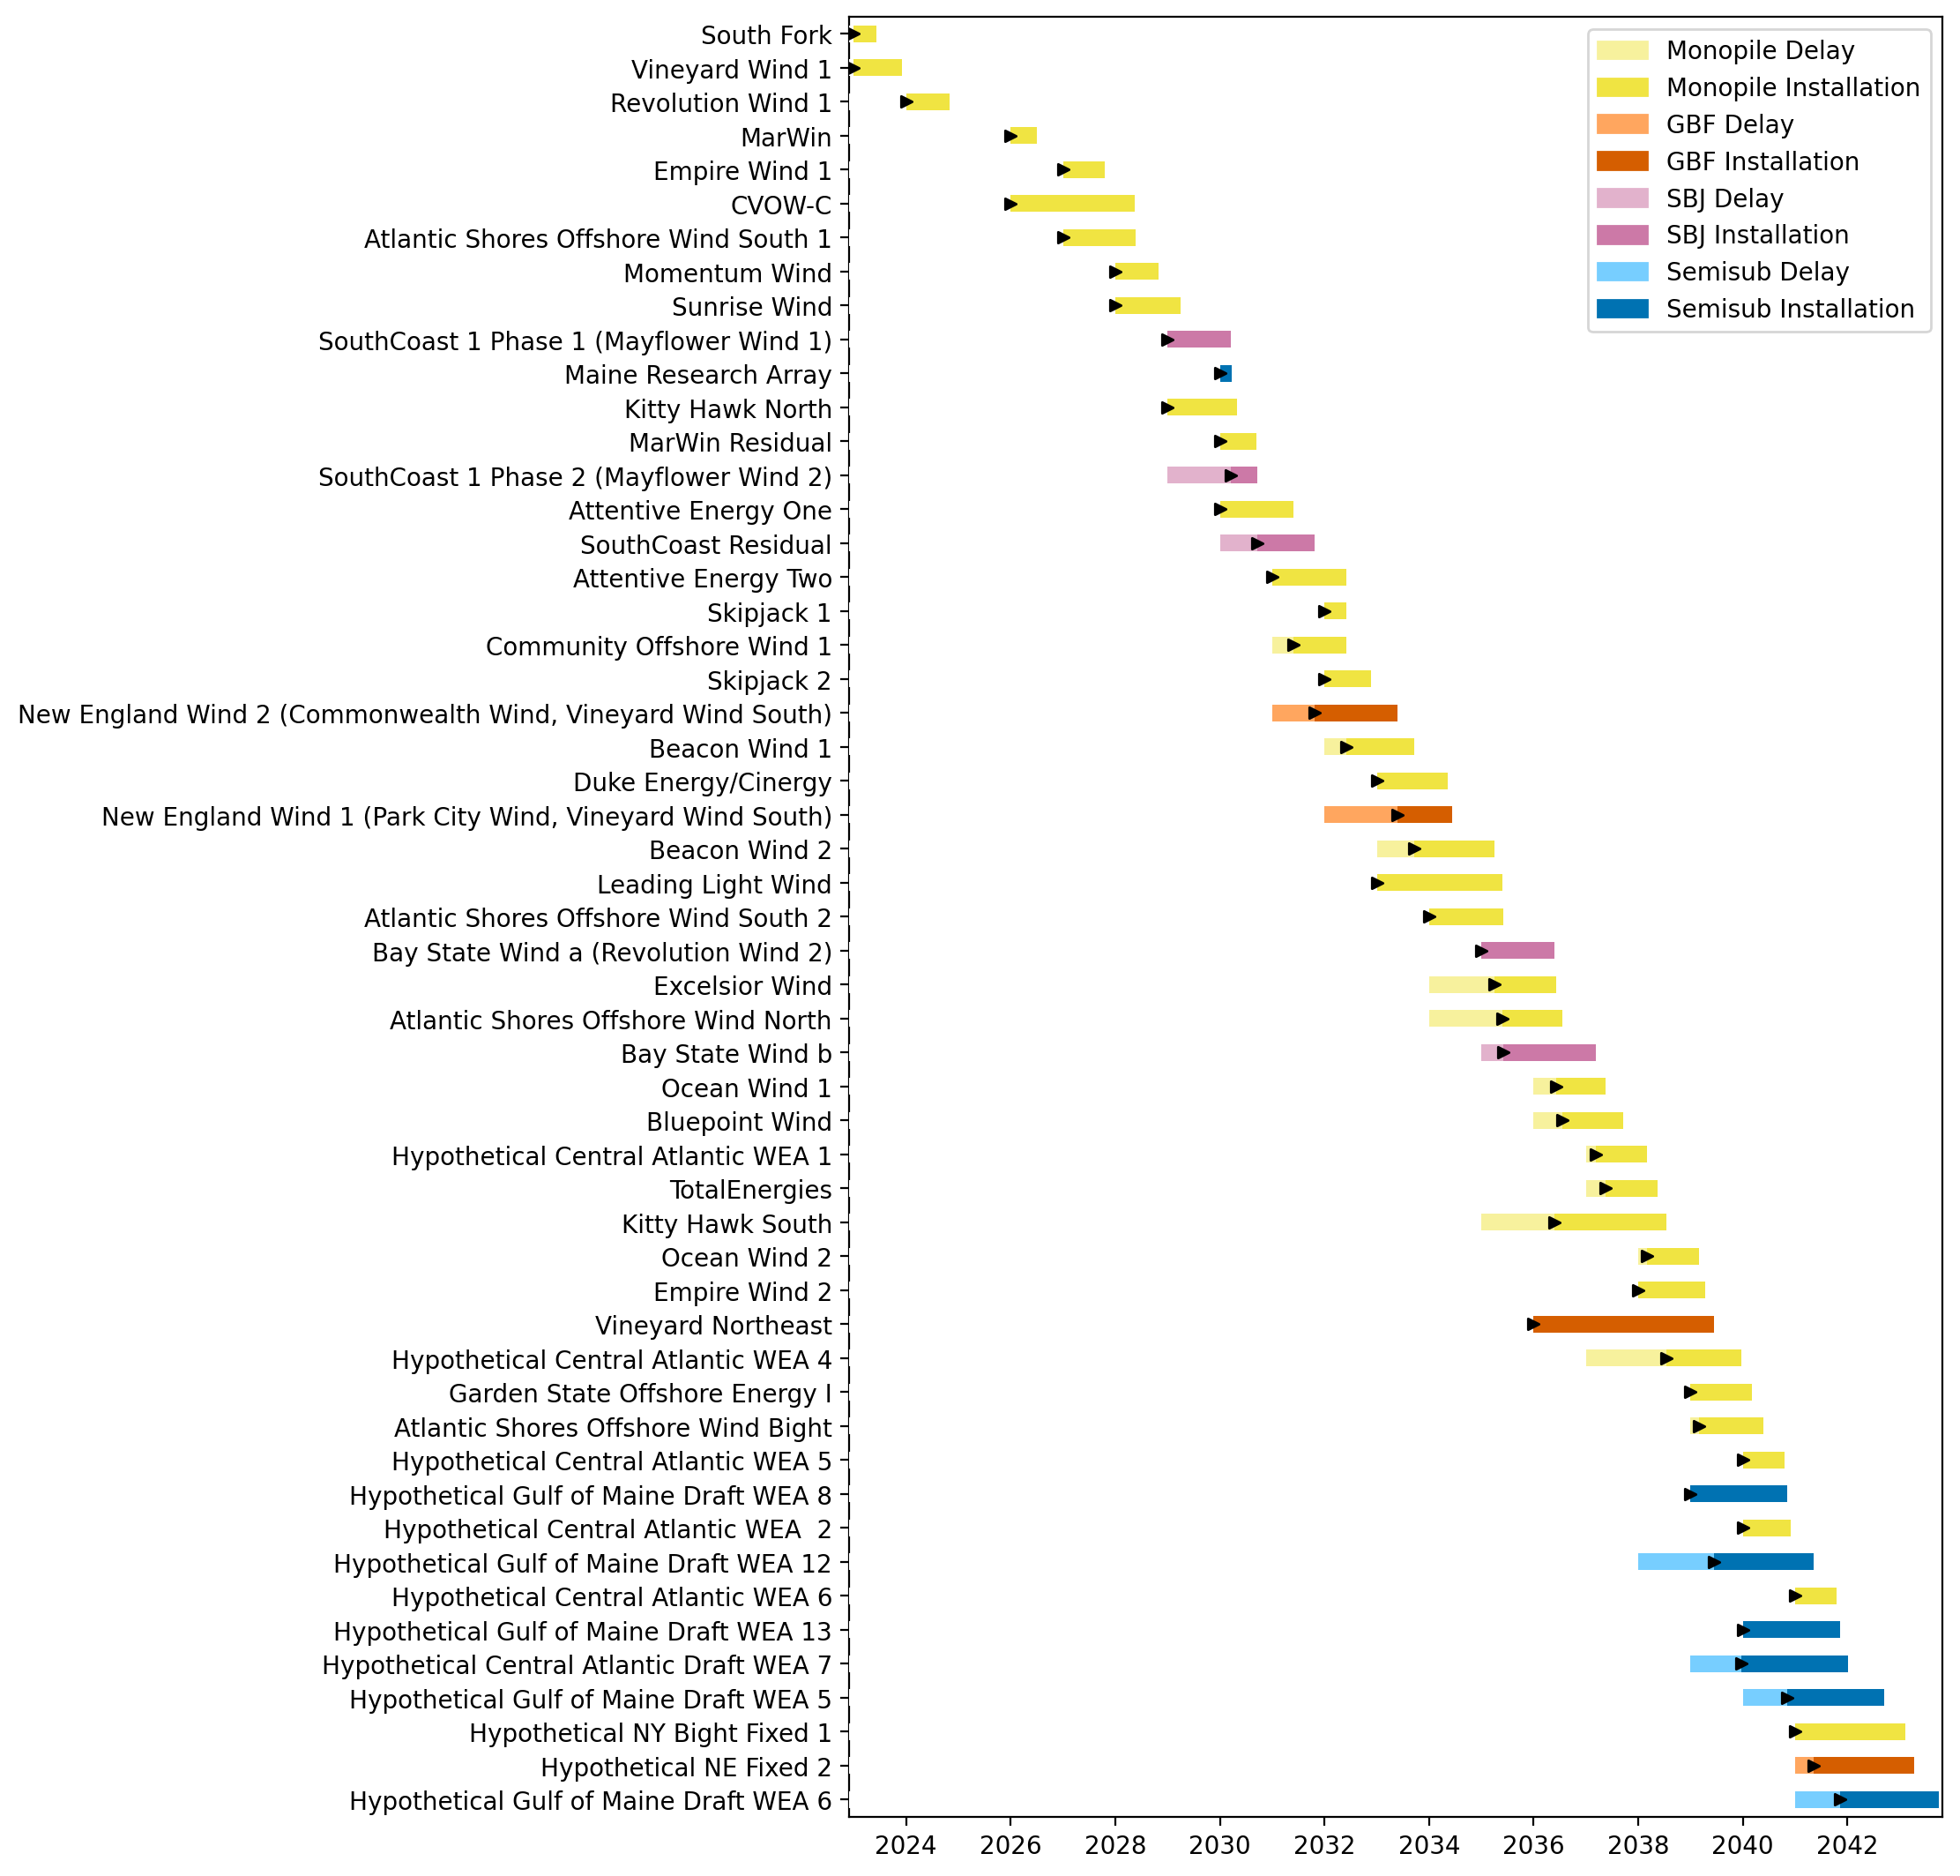
Full Gantt

Slide 32
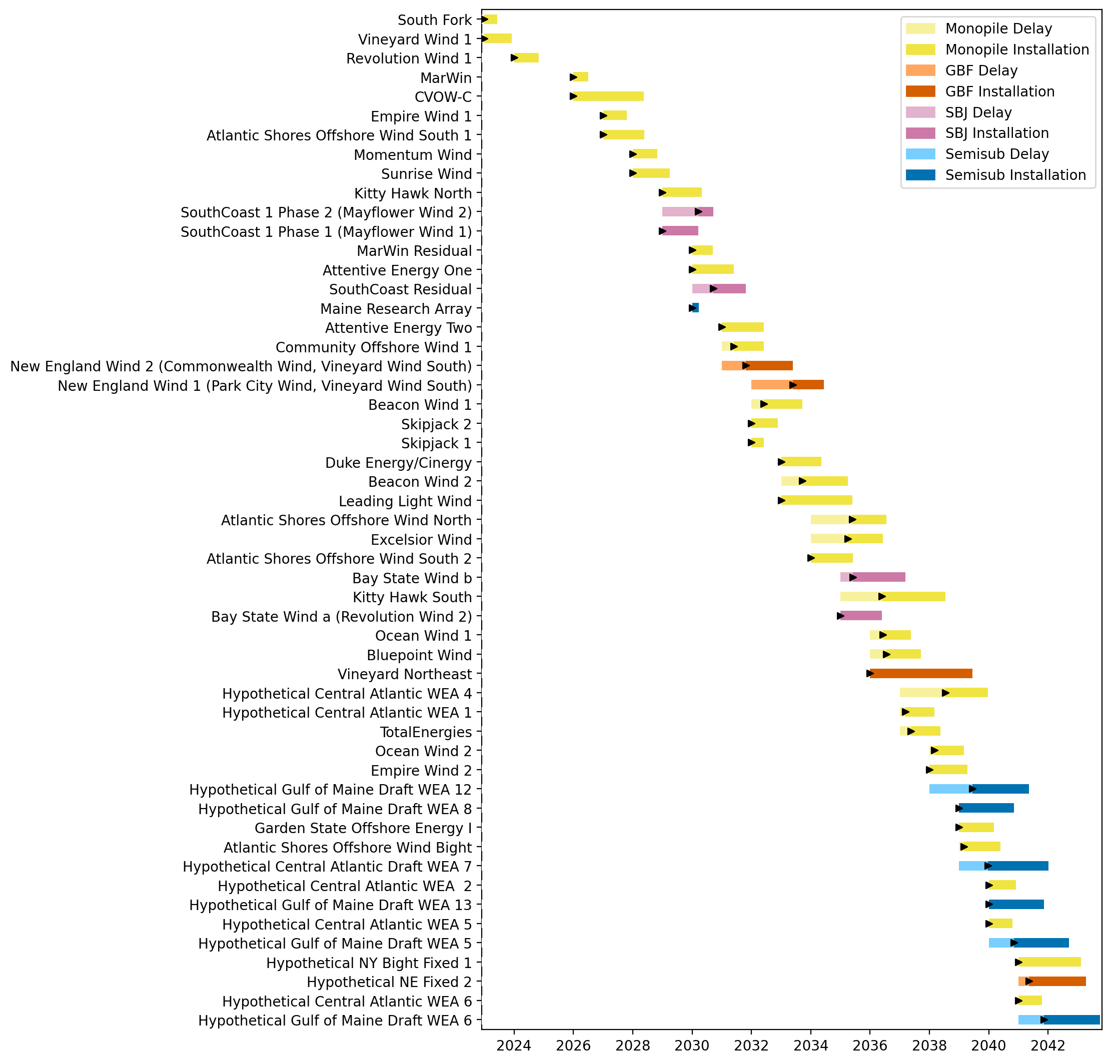
Sorted Full Gantt

Slide 33
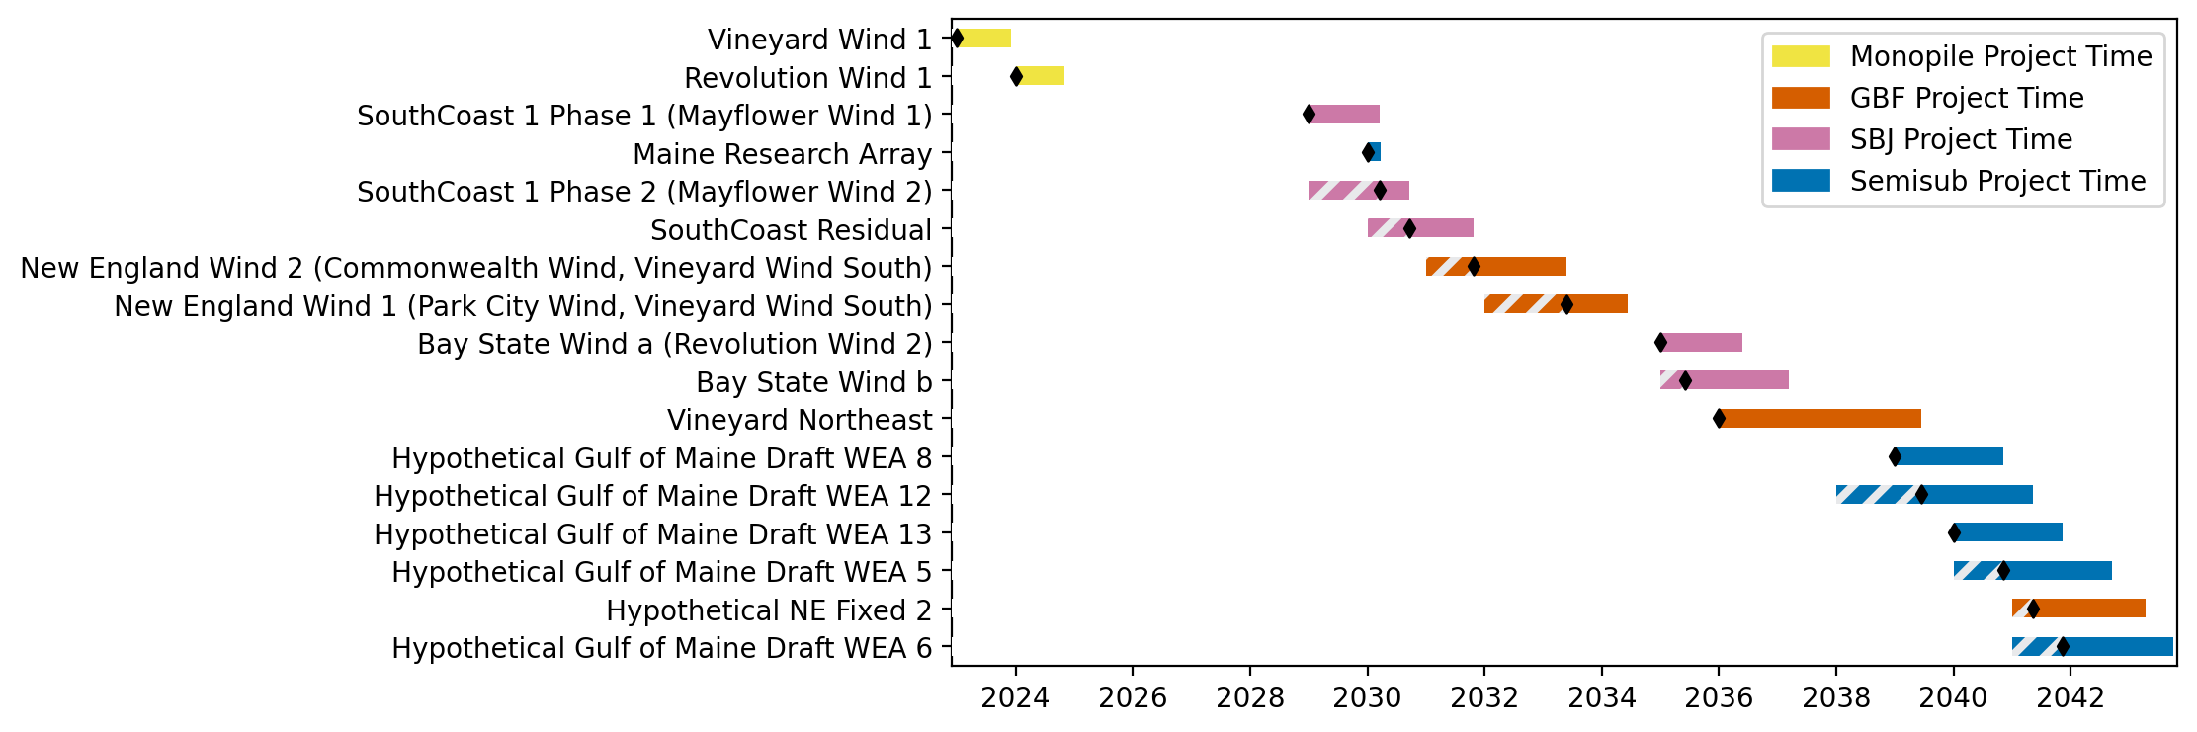
New England Gantt

Slide 34
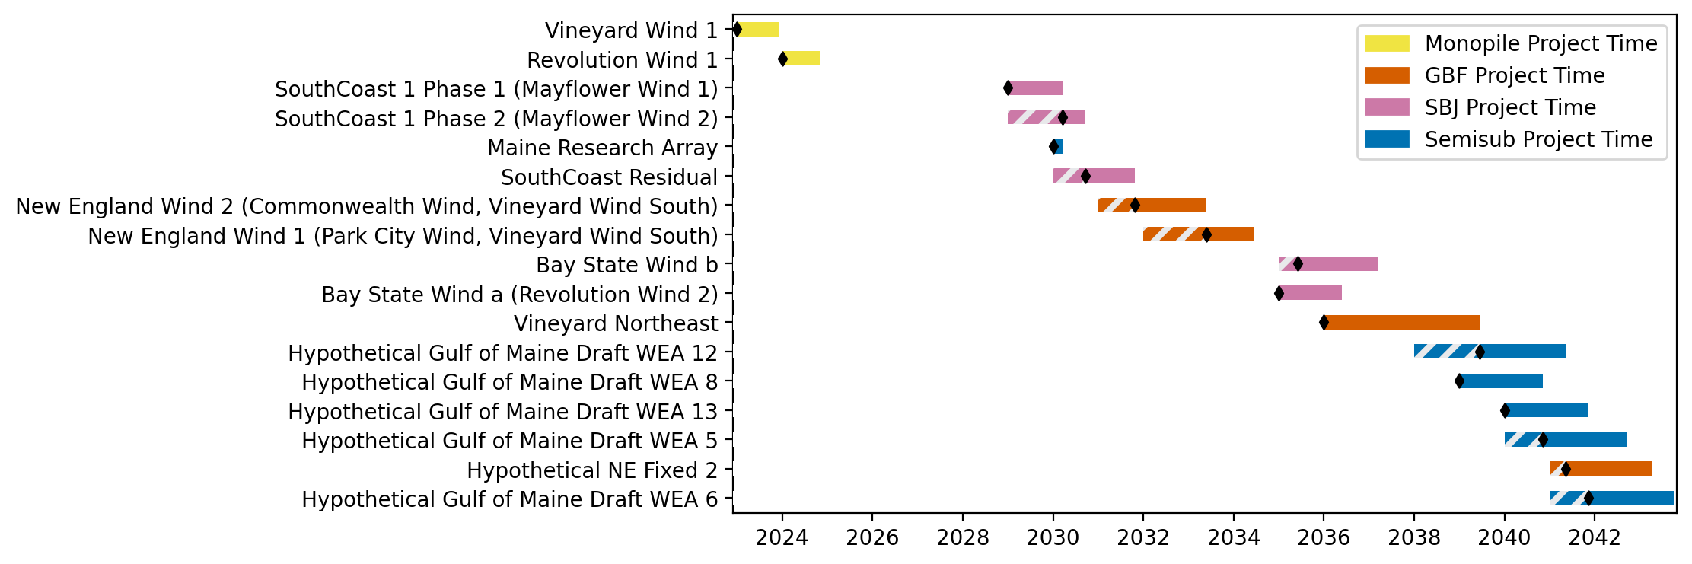
Sorted New England Gantt

Slide 35
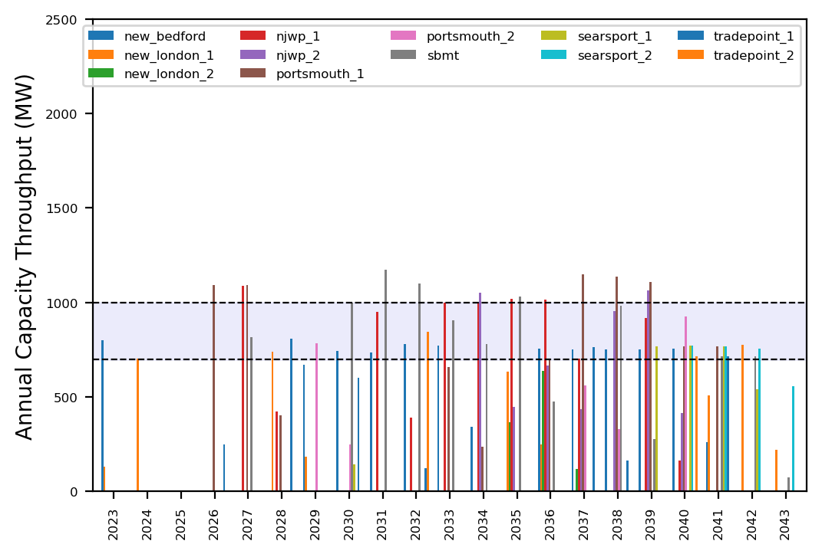
Port Throughput

Slide 36
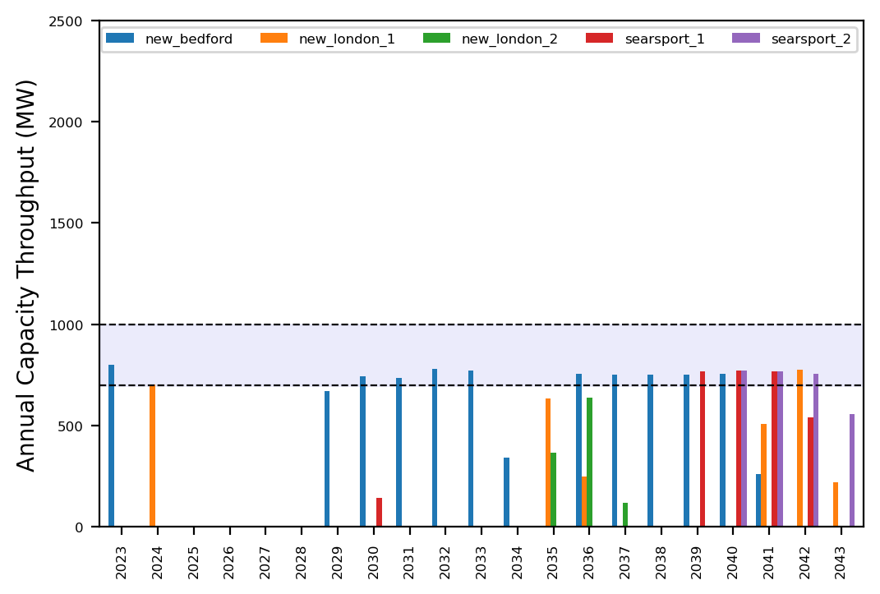
Port Throughput

Slide 37

Full Gantt

Slide 38

Sorted Full Gantt

Slide 39
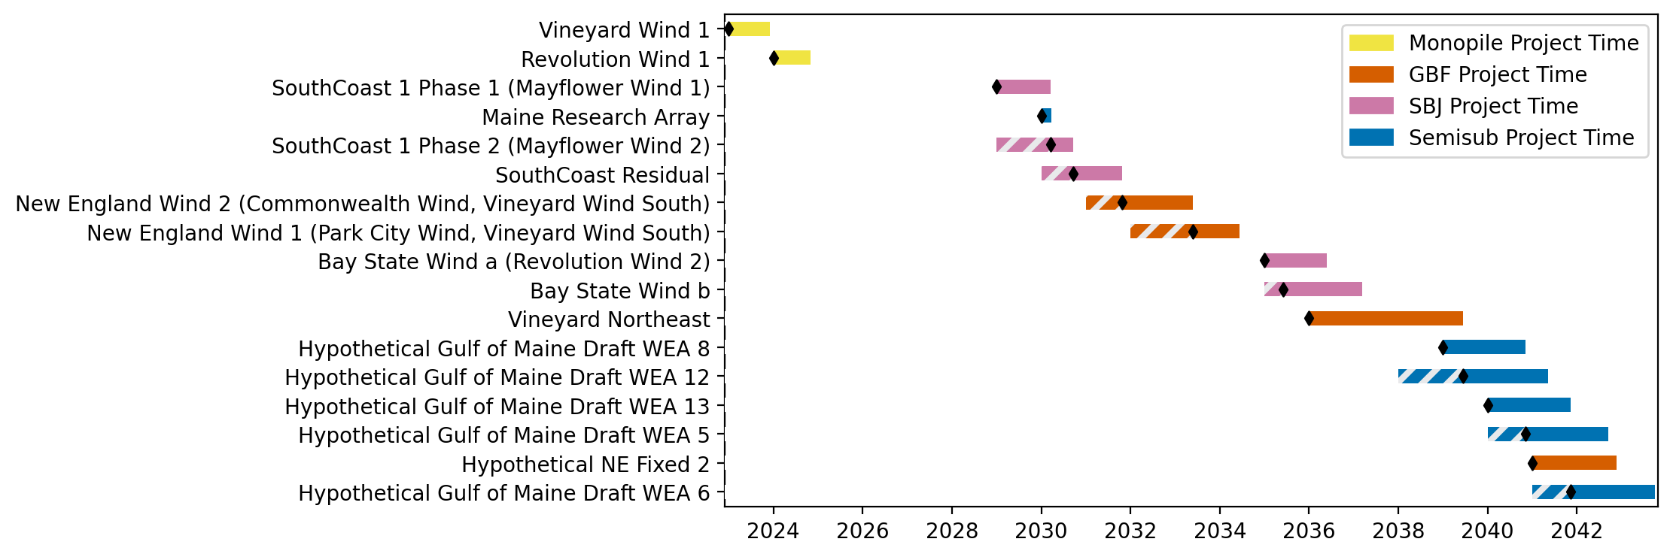
New England Gantt

Slide 40

Sorted New England Gantt

Slide 41
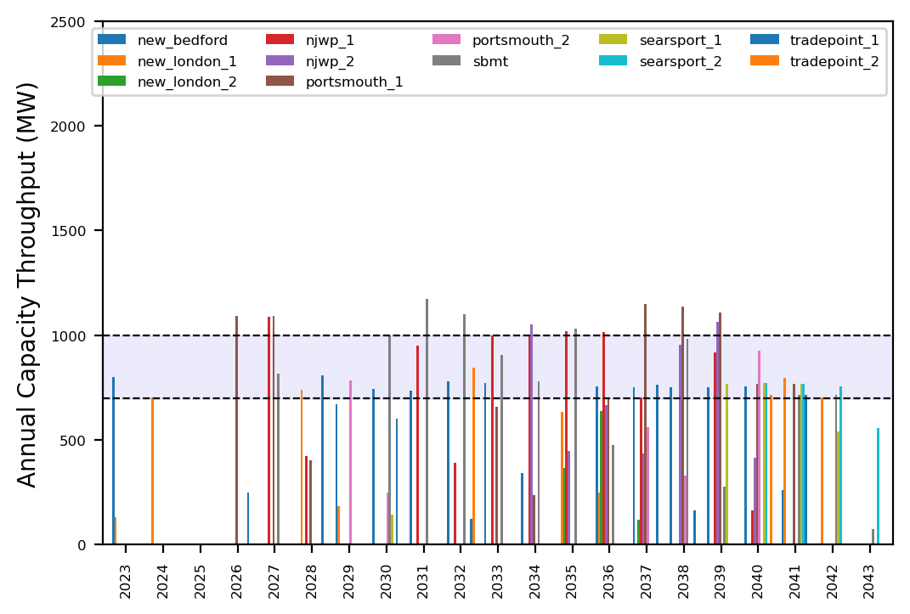
Port Throughput

Slide 42
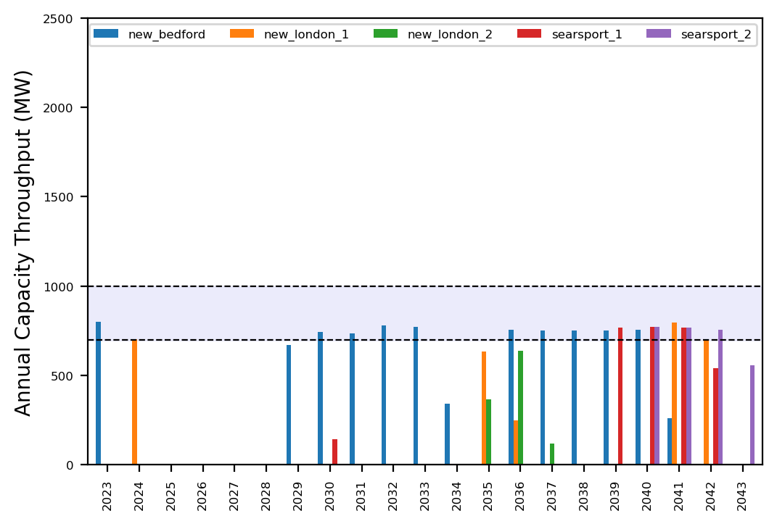
Port Throughput

Slide 43
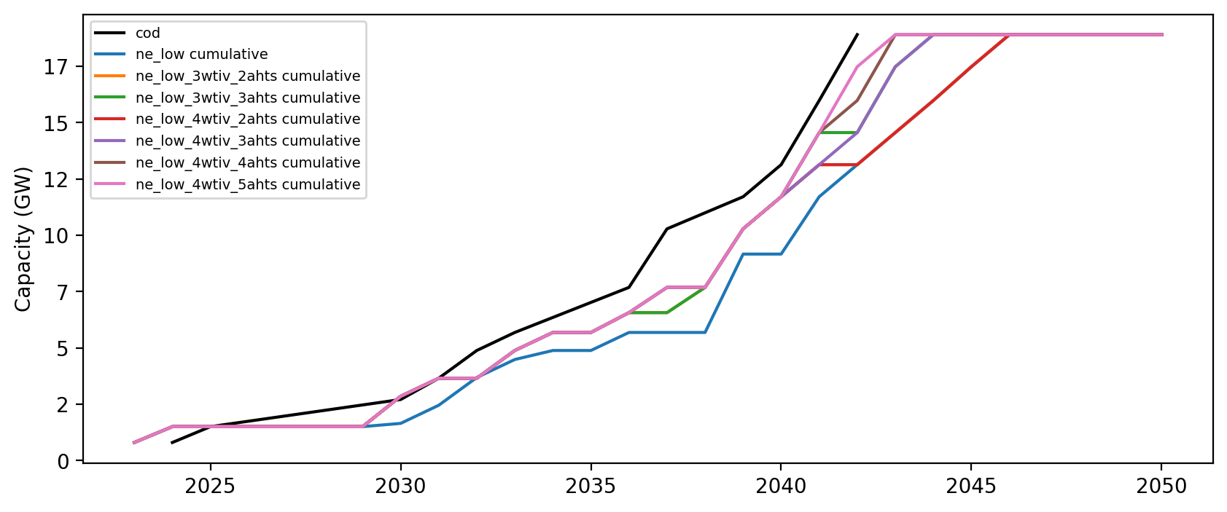
Installed Capacity

